Slide 1
Day 2 Session 6 Challenges and good practices for electronic payment services
Pascal Hetzscholdt | Manila | 27-28 April 2023

Slide 2
INTRODUCTION - SESSION 6: CHALLENGES AND GOOD PRACTICES FOR ELECTRONIC PAYMENT SERVICES
WHY ACT AND PREVENT?
IMPLEMENTING STRONG FRAUD DETECTION AND PREVENTION MEASURES
EDUCATING CUSTOMERS ABOUT INTELLECTUAL PROPERTY RIGHTS
PRACTICE WHAT YOU PREACH
SHARE INVESTIGATIONAL DATA
STOP SUPPORTING FLAGGED SERVICES BY TRUSTED NOTIFIERS
DEVELOP POLICIES AND PROCEDURES
BE PROACTIVE

Slide 3
INTRODUCTION - SESSION 6: CHALLENGES AND GOOD PRACTICES FOR ELECTRONIC PAYMENT SERVICES
WHY ACTION MAY TAKE A WHILE
COMPLEXITY
COSTS
ALIENATING CUSTOMERS (BUSINESS CUSTOMERS AND CONSUMERS)
DON”T TAKE IT SERIOUSLY
COMMERCIAL AGREEMENTS
COMPLICATING FACTORS
VOUCHERS
CRYPTO DONATIONS
UNKNOWN SERVICES (OFFSHORE/SHELL COMPANIES)

Slide 4
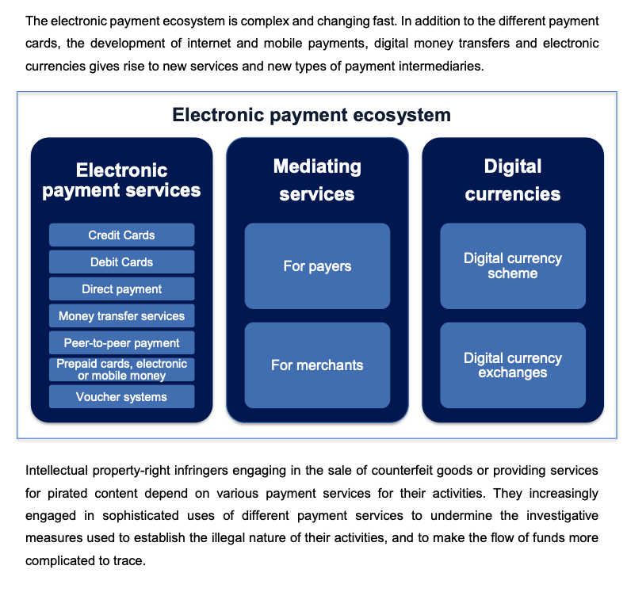
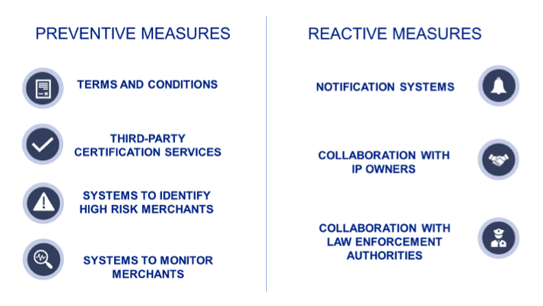
INTRODUCTION - SESSION 6: CHALLENGES AND GOOD PRACTICES FOR ELECTRONIC PAYMENT SERVICES
PAYMENT – DISCUSSION PAPER Challenges and good practices for electronic payment services to prevent the use of their services for intellectual property-infringing activities https://euipo.europa.eu/tunnel-web/secure/webdav/guest/document_library/observatory/documents/reports/2021_payment_discussion_paper/2021_payment_discussion_paper_FullR_en.pdf

Slide 5
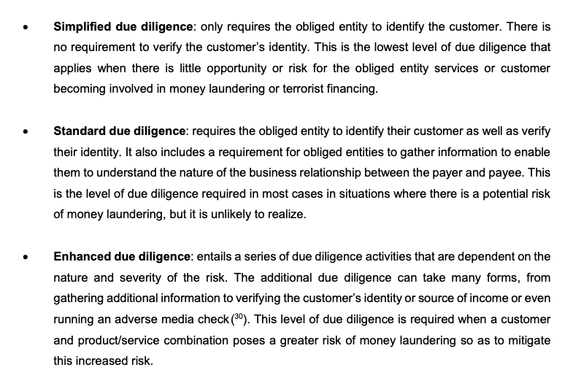
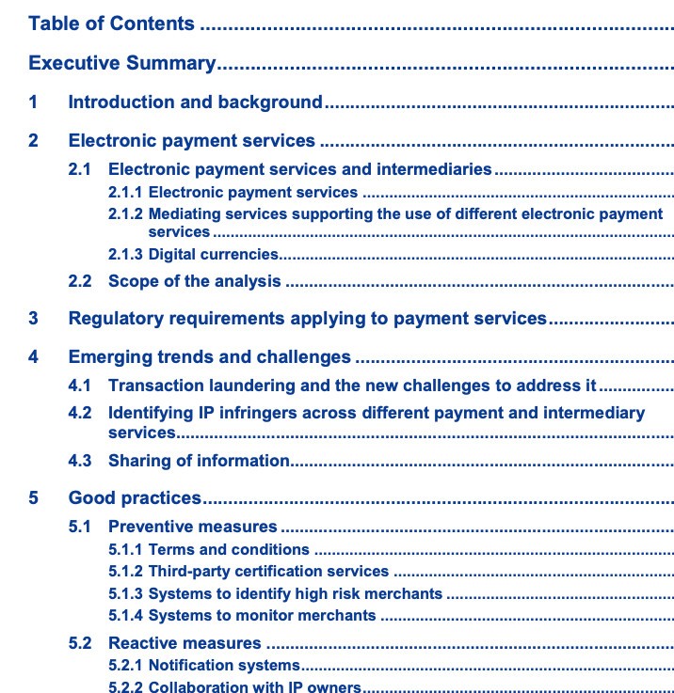
INTRODUCTION - SESSION 6: CHALLENGES AND GOOD PRACTICES FOR ELECTRONIC PAYMENT SERVICES
PAYMENT – DISCUSSION PAPER Challenges and good practices for electronic payment services to prevent the use of their services for intellectual property-infringing activities https://euipo.europa.eu/tunnel-web/secure/webdav/guest/document_library/observatory/documents/reports/2021_payment_discussion_paper/2021_payment_discussion_paper_FullR_en.pdf

Slide 6
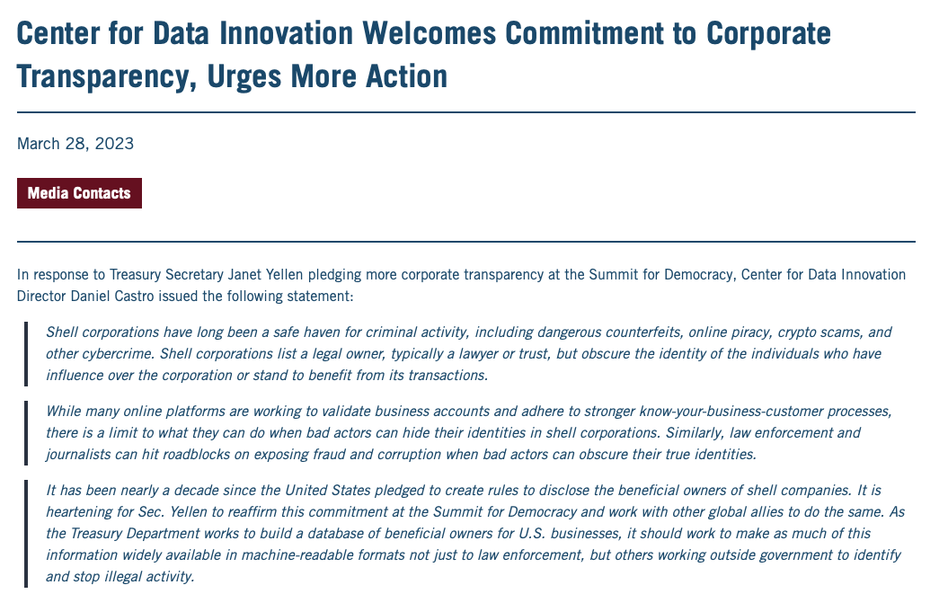
INTRODUCTION - SESSION 6: CHALLENGES AND GOOD PRACTICES FOR ELECTRONIC PAYMENT SERVICES
https://itif.org/publications/2023/03/28/center-for-data-innovation-welcomes-commitment-to-corporate-transparency-urges-more-action/

Slide 7
INTRODUCTION - SESSION 6: CHALLENGES AND GOOD PRACTICES FOR ELECTRONIC PAYMENT SERVICES
https://www.wipo.int/edocs/mdocs/enforcement/en/wipo_ace_15/wipo_ace_15_7_presentations.pdf

Slide 8
INTRODUCTION - SESSION 6: CHALLENGES AND GOOD PRACTICES FOR ELECTRONIC PAYMENT SERVICES
https://www.wipo.int/edocs/mdocs/enforcement/en/wipo_ace_15/wipo_ace_15_7_presentations.pdf

Slide 9
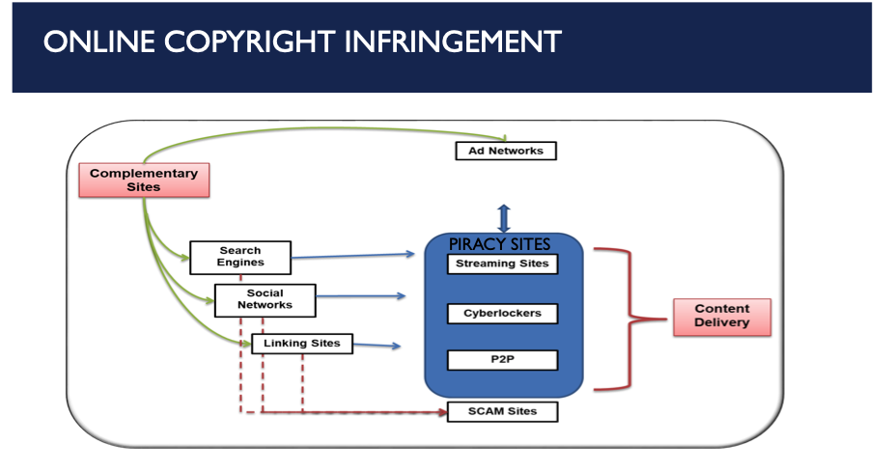
INTRODUCTION - SESSION 6: CHALLENGES AND GOOD PRACTICES FOR ELECTRONIC PAYMENT SERVICES
https://www.wipo.int/edocs/mdocs/enforcement/en/wipo_ace_15/wipo_ace_15_7_presentations.pdf

Slide 10
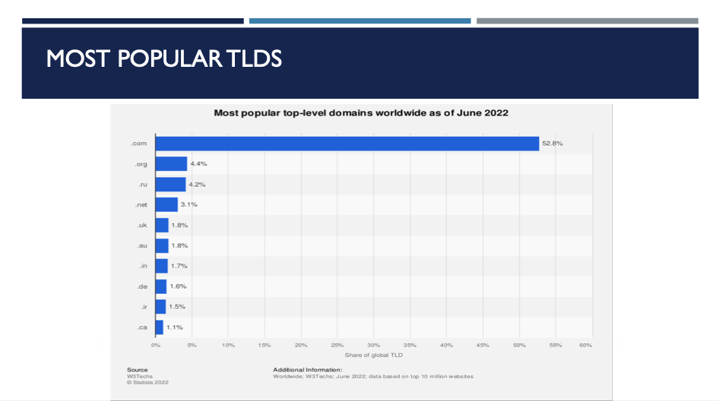
INTRODUCTION - SESSION 6: CHALLENGES AND GOOD PRACTICES FOR ELECTRONIC PAYMENT SERVICES
https://www.wipo.int/edocs/mdocs/enforcement/en/wipo_ace_15/wipo_ace_15_7_presentations.pdf

Slide 11
INTRODUCTION - SESSION 6: CHALLENGES AND GOOD PRACTICES FOR ELECTRONIC PAYMENT SERVICES
https://www.wipo.int/edocs/mdocs/enforcement/en/wipo_ace_15/wipo_ace_15_7_presentations.pdf

Slide 12
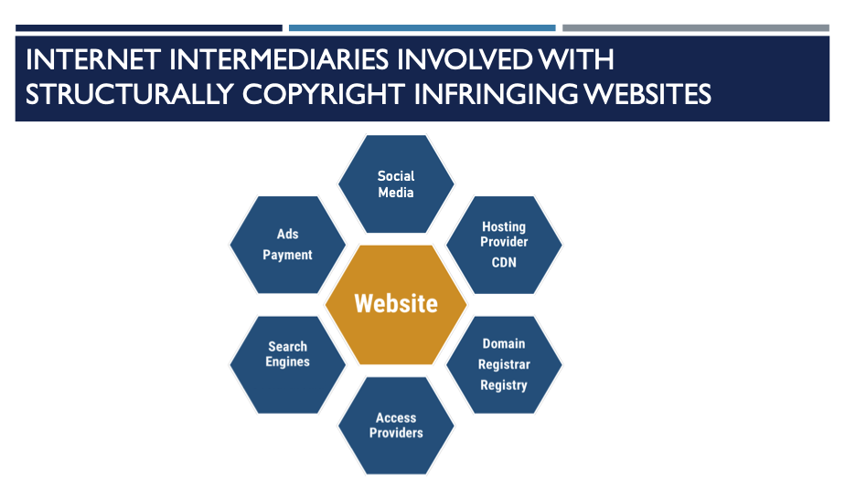
INTRODUCTION - SESSION 6: CHALLENGES AND GOOD PRACTICES FOR ELECTRONIC PAYMENT SERVICES
https://www.wipo.int/edocs/mdocs/enforcement/en/wipo_ace_15/wipo_ace_15_7_presentations.pdf

Slide 13
INTRODUCTION - SESSION 6: CHALLENGES AND GOOD PRACTICES FOR ELECTRONIC PAYMENT SERVICES
https://www.wipo.int/edocs/mdocs/enforcement/en/wipo_ace_15/wipo_ace_15_7_presentations.pdf

Slide 14
INTRODUCTION - SESSION 6: CHALLENGES AND GOOD PRACTICES FOR ELECTRONIC PAYMENT SERVICES
https://www.wipo.int/edocs/mdocs/enforcement/en/wipo_ace_15/wipo_ace_15_7_presentations.pdf

Slide 15
INTRODUCTION - SESSION 6: CHALLENGES AND GOOD PRACTICES FOR ELECTRONIC PAYMENT SERVICES
https://www.wipo.int/edocs/mdocs/enforcement/en/wipo_ace_15/wipo_ace_15_7_presentations.pdf

Slide 16
INTRODUCTION - SESSION 6: CHALLENGES AND GOOD PRACTICES FOR ELECTRONIC PAYMENT SERVICES
https://www.wipo.int/edocs/mdocs/enforcement/en/wipo_ace_15/wipo_ace_15_7_presentations.pdf

Slide 17
INTRODUCTION - SESSION 6: CHALLENGES AND GOOD PRACTICES FOR ELECTRONIC PAYMENT SERVICES
https://www.wipo.int/edocs/mdocs/enforcement/en/wipo_ace_15/wipo_ace_15_7_presentations.pdf

Slide 18
INTRODUCTION - SESSION 6: CHALLENGES AND GOOD PRACTICES FOR ELECTRONIC PAYMENT SERVICES
https://www.wipo.int/edocs/mdocs/enforcement/en/wipo_ace_15/wipo_ace_15_7_presentations.pdf

Slide 19
Q&A

Slide 20
THANK YOU

