Slide 1
Day 2 Session 5 The Use of Intermediary Services in IP Infringing Activities
Pascal Hetzscholdt | Manila | 27-28 April 2023

Slide 2
INTRODUCTION - SESSION 5: THE USE OF INTERMEDIARY SERVICES IN IP INFRINGING ACTIVITIES
IP CRIME:
DISRUPTS E-COMMERCE
ENDANGERS INNOVATION (INCORRECT DATA AS A BASIS FOR AI)
ERODES TRUST (FLAWED DATA, COMPROMISED SYSTEMS, DATA, SERVICES)
FINANCIAL DAMAGE
FINANCES OTHER CRIMES, CYBERCRIMES, TERRORISM
MONEY LAUNDERING / TAX EVASION
ERODES THE CONCEPT OF YOURS & MINE
REMOVES ACCOUNTABILITY
AFFECTS THE ROLE, SIGNIFICANCE OF THE GOVERNMENT AND THE RULE OF LAW
ERODES BUYING READINESS AND PRICE AWARENESS
TAKES AWAY THE NOTION THAT DIGITAL OBJECTS CAN HAVE A VALUE

Slide 3
INTRODUCTION - SESSION 5: THE USE OF INTERMEDIARY SERVICES IN IP INFRINGING ACTIVITIES
MYTHS
EASY ACCESS, LOW COSTS
WHACK-A-MOLE
FREEDOM OF SPEECH
NOT SURE WHETHER LEGAL/ILLEGAL
WHY BUSINESSES ENGAGE IN ANTI-PIRACY
LAW & ORDER, ROBUST MARKETPLACE
BUSINESS INTELLIGENCE
LOSS PREVENTION / RECOVERY
ILLEGAL COMPETITION (TAXES, FRAUD, ANTI-TRUST, CYBERCRIME)

Slide 4
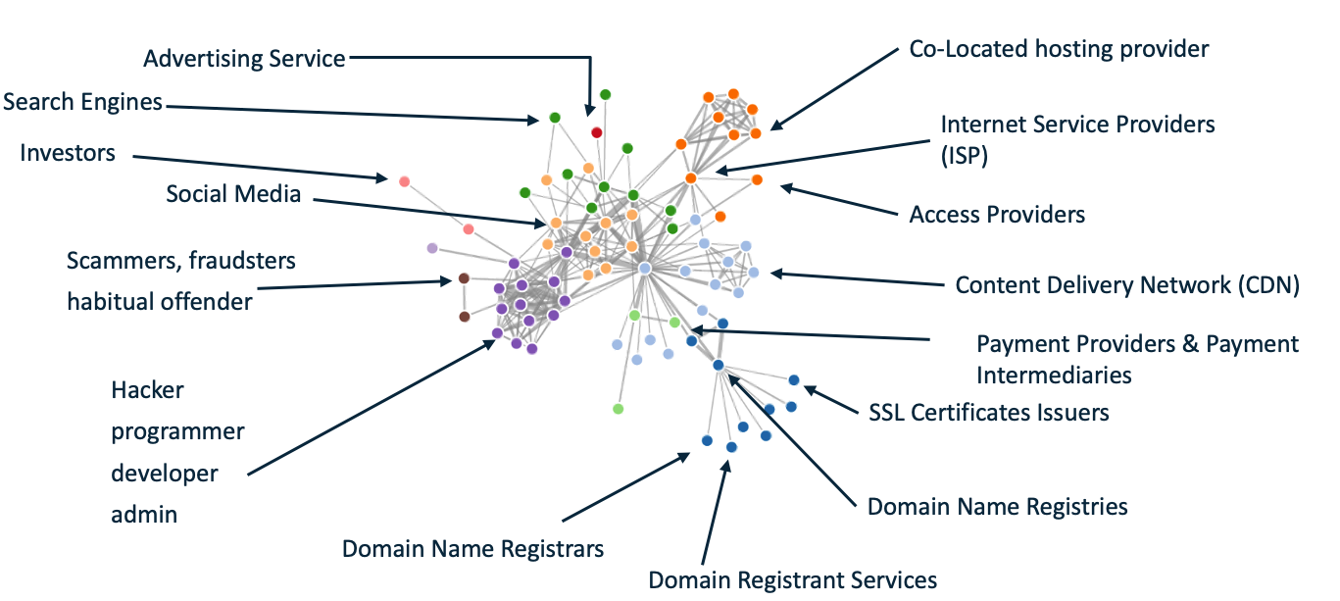
SESSION 5: THE USE OF INTERMEDIARY SERVICES IN IP INFRINGING ACTIVITIES

Slide 5
SESSION 5: THE USE OF INTERMEDIARY SERVICES IN IP INFRINGING ACTIVITIES
PIRATEBAY - HTTPS://EN.WIKIPEDIA.ORG/WIKI/THE_PIRATE_BAY
MEGAUPLOAD - HTTPS://EN.WIKIPEDIA.ORG/WIKI/MEGAUPLOAD
SURFTHECHANNEL - HTTPS://EN.WIKIPEDIA.ORG/WIKI/SURFTHECHANNEL
CYBERBUNKER - HTTPS://EN.WIKIPEDIA.ORG/WIKI/CYBERBUNKER
BEOUTQ - HTTPS://EN.WIKIPEDIA.ORG/WIKI/BEOUTQ
RAPIDSHARE - HTTPS://EN.WIKIPEDIA.ORG/WIKI/RAPIDSHARE
SCI-HUB - HTTPS://EN.WIKIPEDIA.ORG/WIKI/SCI-HUB
LIBGEN - HTTPS://EN.WIKIPEDIA.ORG/WIKI/LIBRARY_GENESIS
Z-LIBRARY - HTTPS://EN.WIKIPEDIA.ORG/WIKI/Z-LIBRARY

Slide 6
SESSION 5: THE USE OF INTERMEDIARY SERVICES IN IP INFRINGING ACTIVITIES
COMMONALITIES:
LARGE-SCALE COMMERCIAL LEVEL EXPLOITATION OF PIRATED FILES,
ADVERTISING, DONATIONS, SUBSCRIPTIONS,
CRIMINAL OPERATIONS BACKED BY POWERFUL ENTITIES,
LEGAL REMEDIES CAN TAKE DECADES, LAW ENFORCEMENT SUPPORT CRITICAL,
LEGAL FRAMEWORK AND REGULATION CRITICAL,
(DYNAMIC) BLOCKING INJUNCTIONS CRITICAL,
POLICY REGARDING FACILITATION CRITICAL,
PIRACY INVESTIGATION GATEWAY TO MANY OTHER CRIMES.

Slide 7
SESSION 5: THE USE OF INTERMEDIARY SERVICES IN IP INFRINGING ACTIVITIES
Z-LIBRARY
Z-LIBRARY IS A PIRACY PLATFORM WITH MORE THAN 11 MILLION INFRINGING COPIES OF BOOKS AND 84 MILLION INFRINGING COPIES OF RESEARCH PAPERS, WITH CONNECTIONS TO THE LIBRARY GENESIS AND SCI-HUB PIRATE SITES. INTERNET USERS CAN UPLOAD CONTENT TO THE SITE (INCLUDING CONVERTED AMAZON KINDLE CONTENT). E-MAILS WITH PIRATED DIGITAL BOOKS ATTACHED WERE ALSO SENT TO INTERNET USERS FROM Z-LIBRARY WEBSITES
3,940TH MOST VISITED PLATFORM IN THE WORLD
CONSISTS OF 249 (CONNECTED AND MIRRORED) WEBSITES
23 MILLION MONTHLY USERS
BLOCKED IN FR, BANNED IN IN
SELECTION OF HOSTING LOCATIONS: NL, CH, CN, VU, BG, RU, FR, US

Slide 8
SESSION 5: THE USE OF INTERMEDIARY SERVICES IN IP INFRINGING ACTIVITIES
Z-LIBRARY
CORE OF OPERATION LOCATED IN RU. NATIONALITY OF MAIN OPERATORS: RU
SIZE OF OPERATION: ESTIMATED AT 10-15 PERSONS. SIZE OF CONTENT DATABASE: 220 TERABYTES
SITE OFFERED CAPPED NUMBER OF FREE DOWNLOADS, SUBSCRIPTION PLANS, DONATIONS, ADVERTISING REVENUE (GOOGLE ADSENSE)
ACCEPTS PAYMENT VIA VISA, AMERICAN EXPRESS, ALIPAY, BITCOIN, AND AMAZON.COM GIFT CARDS
# TWEETS AFTER TAKEDOWN OF DOMAINS: 8K+. # TWEETS AFTER INDICTMENT: 1.5K+
NEWS POSTS AFTER TAKEDOWN OF DOMAINS: 80+ (BLOGS, WEB FORA, TECH SITES)
NEWS ARTICLES AFTER INDICTMENT: 50+ (MAINSTREAM MEDIA)
CHARGES AGAINST TWO DEFENDANTS: CRIMINAL COPYRIGHT, CONSPIRACY TO COMMIT WIRE FRAUD, WIRE FRAUD, MONEY LAUNDERING CONSPIRACY

Slide 9
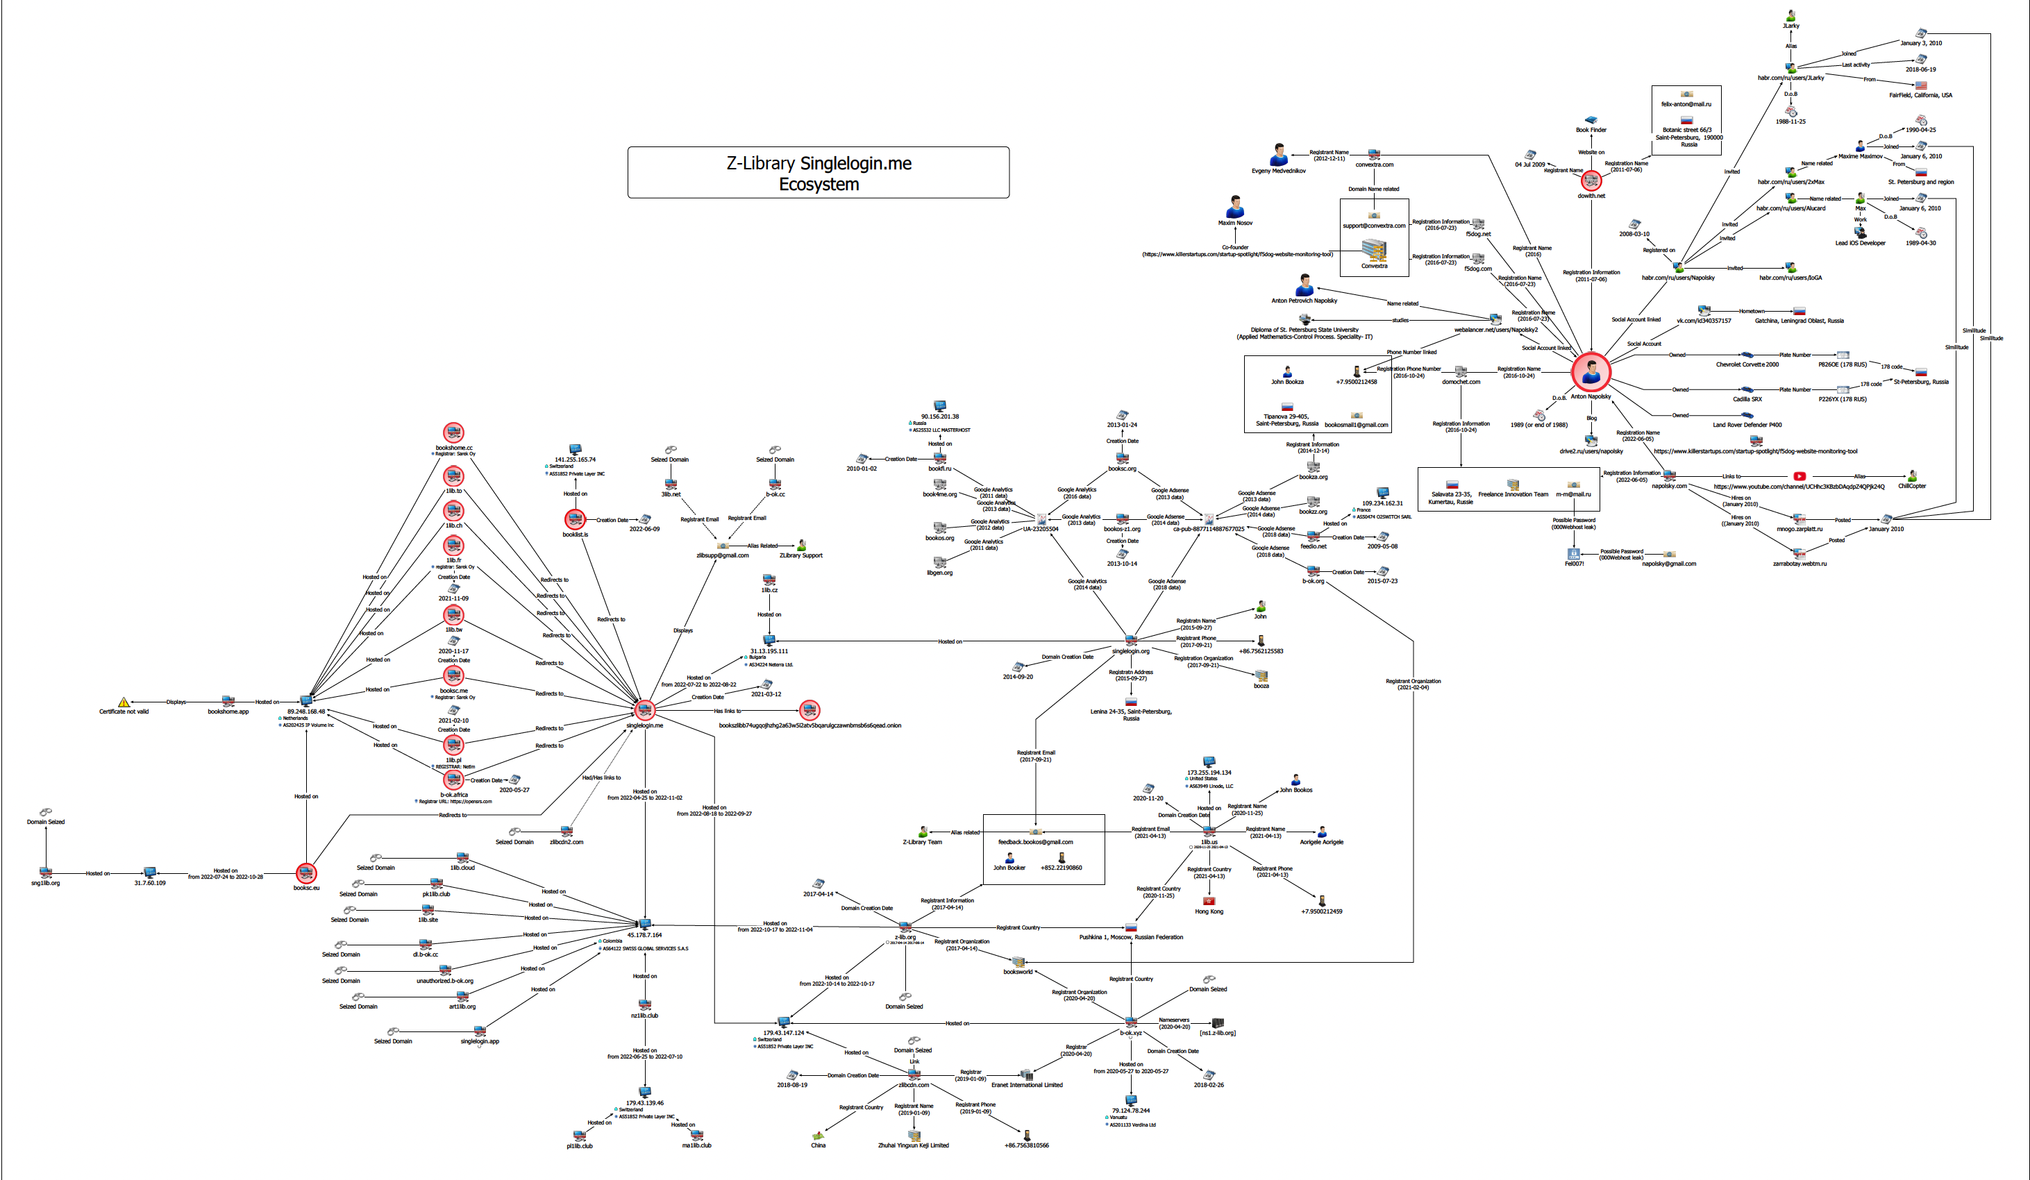
SESSION 5: THE USE OF INTERMEDIARY SERVICES IN IP INFRINGING ACTIVITIES
ADS

Slide 10
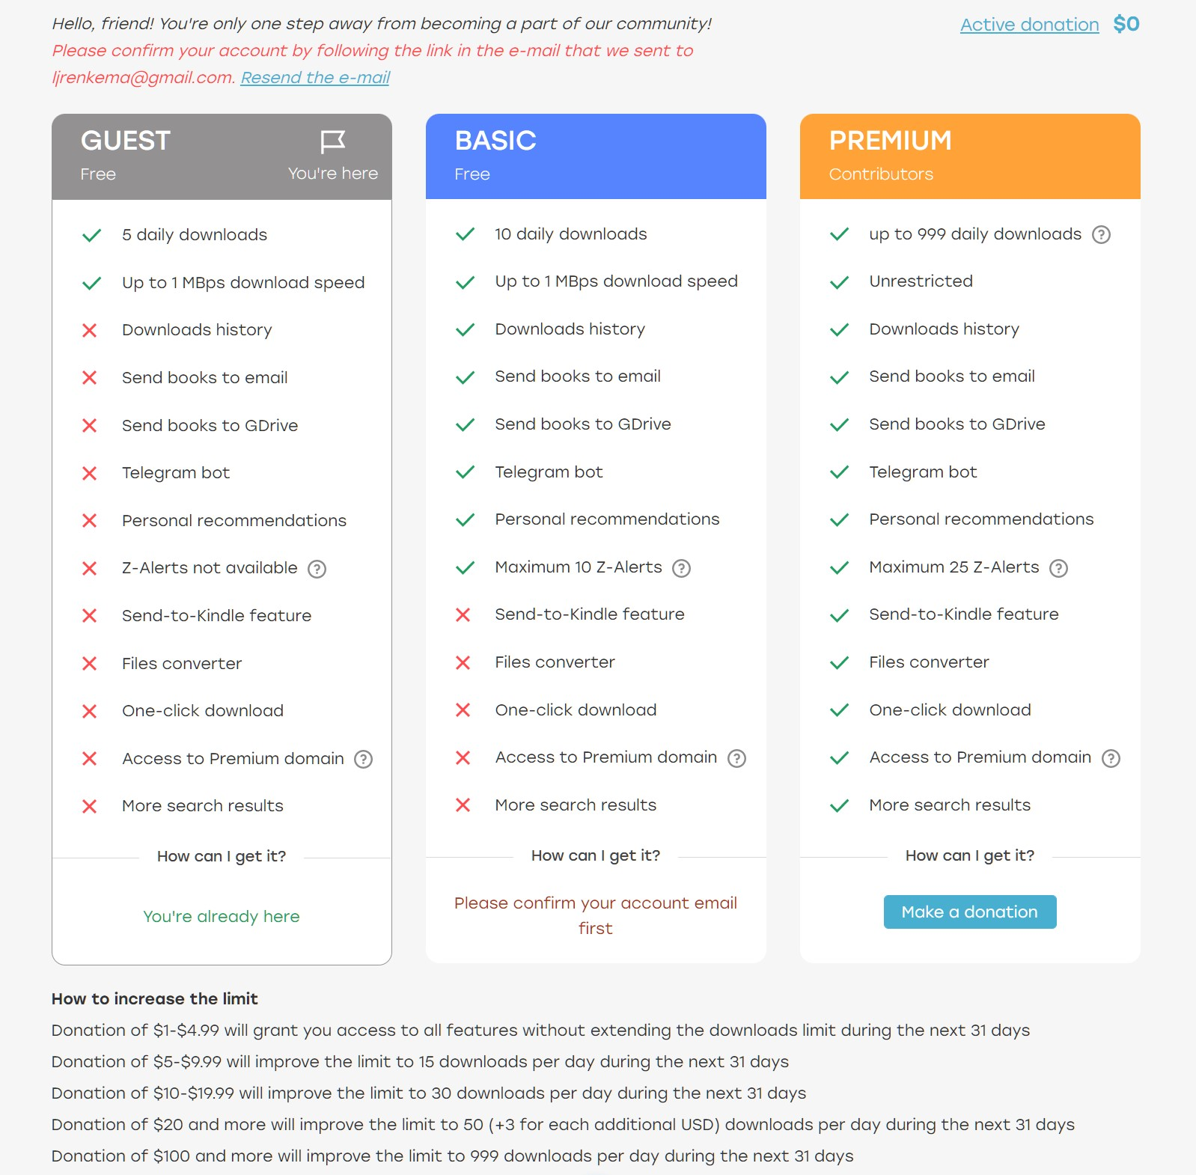
Source: https://torrentfreak.com/images/premium.jpg
https://torrentfreak.com/tiktok-blocks-z-library-hashtag-pending-piracy-investigation-221031/

Slide 11
SESSION 5: THE USE OF INTERMEDIARY SERVICES IN IP INFRINGING ACTIVITIES
“We applaud the Department of Justice for taking decisive action against the operators of Z-Library. There is a growing — and
disturbing — trend of pirate operations masquerading as libraries to manipulate and evade the law. This action sends a clear
message that industrial scale infringement will not be tolerated, no matter what the perpetrators call themselves. We are grateful
for the hard work of the FBI, as well as the Authors Guild and the UK Publishers Association, in stopping this infringing enterprise.”
Lui Simpson, Senior Vice President, Global Policy for the Association of American Publishers (AAP), on the DOJ’s Recent Action
in the Z Library Case
https://publishers.org/news/comment-from-lui-simpson-senior-vice-president-global-policy-for-the-association-of-american-publishers-aap-on-the-dojs-recent-action-in-the-z-library-case/
“The arrest and indictment of Z-Library operators is one of the biggest breakthroughs in the fight against online criminal e-book piracy
to date,” said Authors Guild CEO Mary Rasenberger, in a statement thanking the U.S. Attorney’s Office for the Eastern District of
New York and to the FBI for shutting down the site and arresting the principals. “While we are heartened by the takedown and the
resulting reduction in harm to authors, we are not unsympathetic to the plight of those college and other students who have perhaps
felt forced to resort to such illegal pirate websites and other free sources of textbooks to help them manage the extremely high cost
of higher education," Rasenberger said. "However, these students’ anger is misdirected. The exorbitant cost of education should not
be borne by authors and publishers but by the universities, and it should not be used to justify reliance on foreign criminals for
textbooks or to trivialize the immense personal and economic harm Z-Library was causing authors who are trying to make a living
under increasingly difficult and hostile economic circumstances.”
https://www.publishersweekly.com/pw/by-topic/industry-news/publisher-news/article/90944-authors-guild-applauds-arrest-indictment-of-major-e-book-pirates.html

Slide 12
SESSION 5: THE USE OF INTERMEDIARY SERVICES IN IP INFRINGING ACTIVITIES
“As alleged, the defendants profited illegally off work they stole, often uploading works within mere hours of publication, and in the process victimized authors, publishers and booksellers,” stated United States Attorney Peace.
“This Office is committed to protecting the intellectual property rights that enable creative and artistic expression, and holding individuals accountable for threatening those rights. The defendants are alleged to have operated a website for over a decade whose central purpose was providing stolen intellectual property, in violation of copyright laws.
Intellectual property theft crimes deprive their victims of both ingenuity and hard-earned revenue. The FBI is determined to ensure those willing to steal and profit from the creativity of others are stopped and made to face the consequences in the criminal justice system.”
https://www.justice.gov/usao-edny/pr/two-russian-nationals-charged-running-massive-e-book-piracy-website

Slide 13
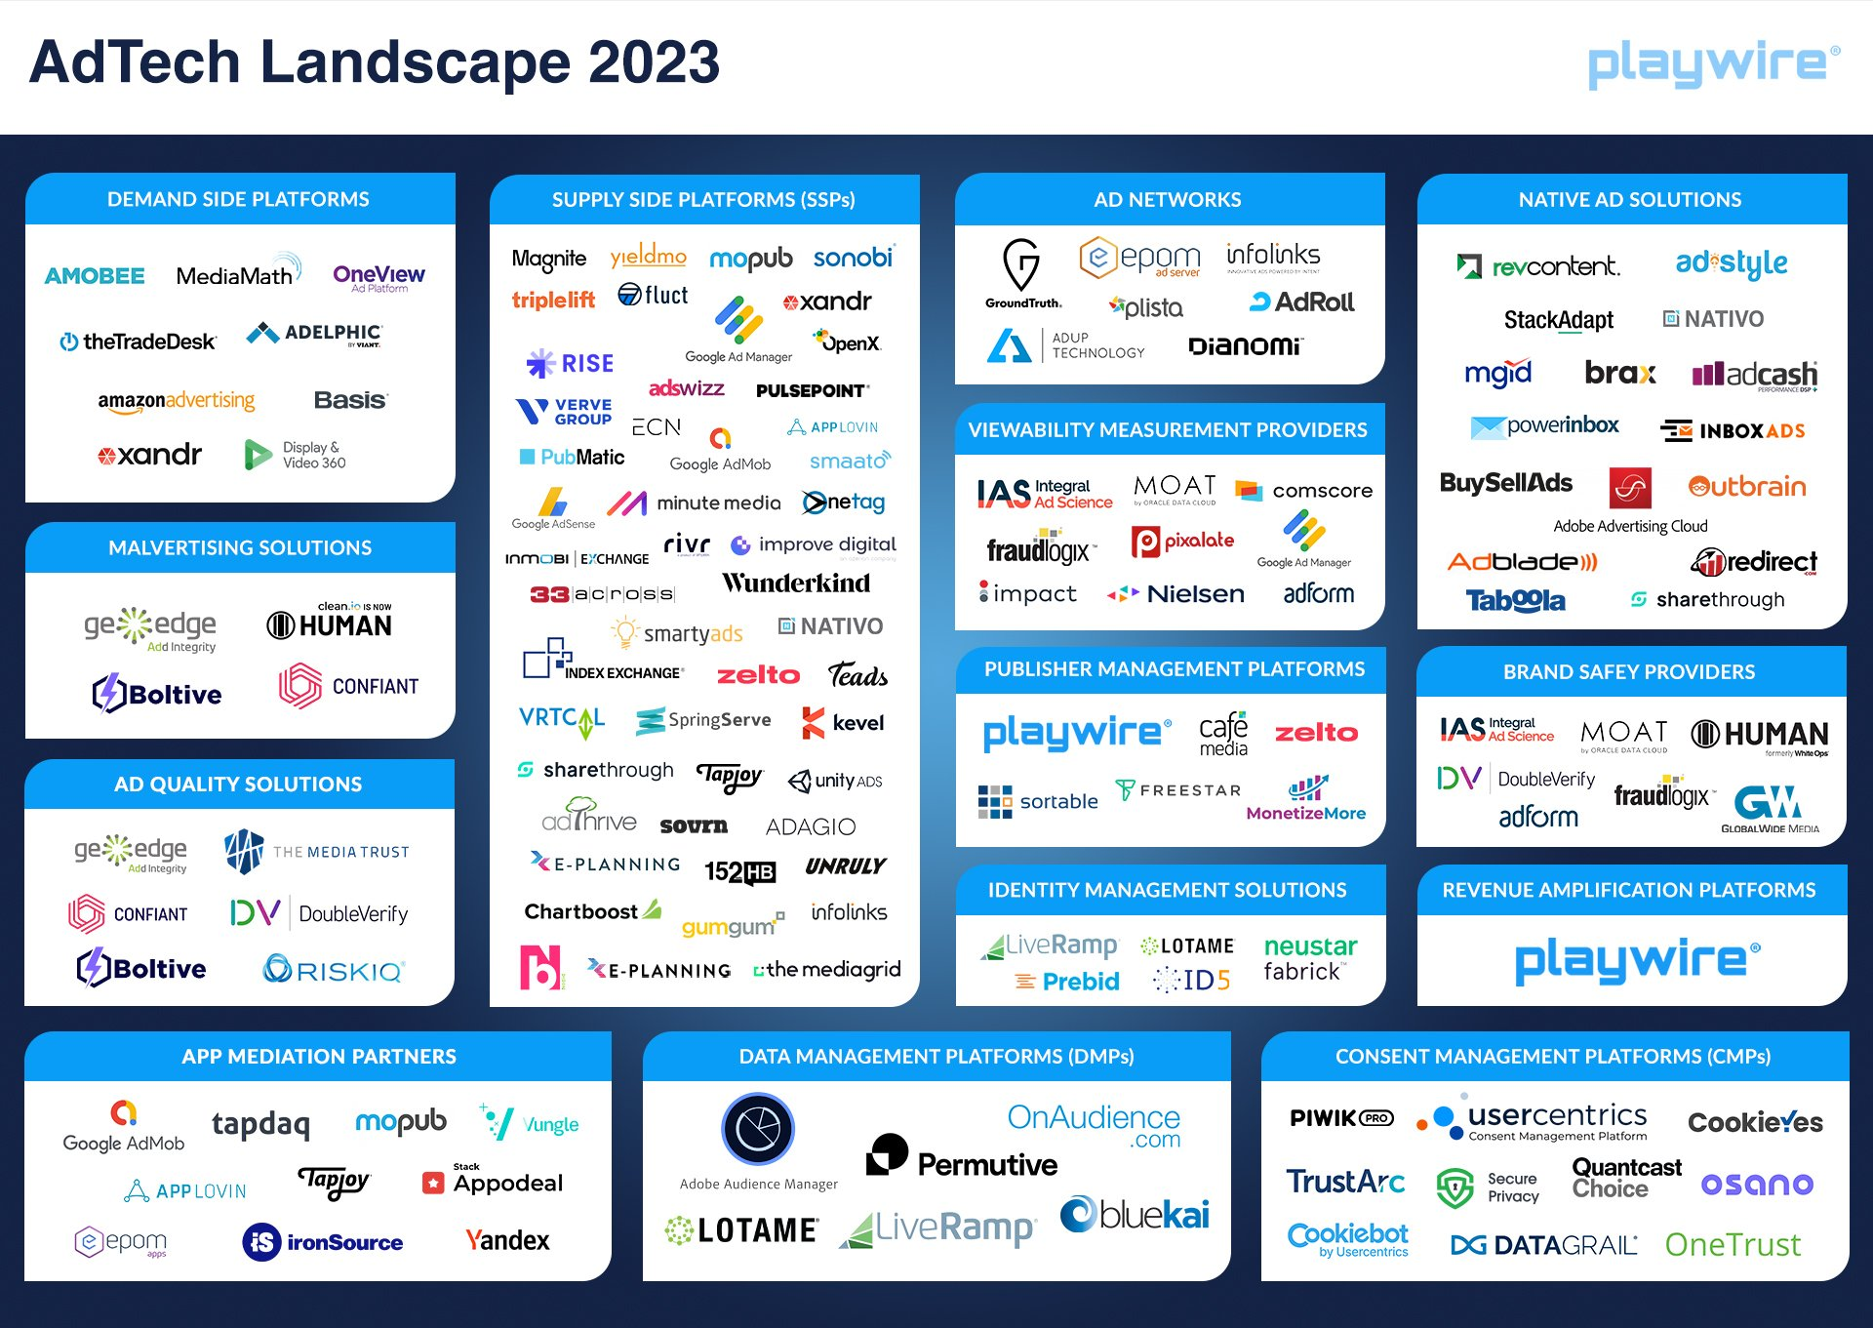
SESSION 5: THE USE OF INTERMEDIARY SERVICES IN IP INFRINGING ACTIVITIES
The complexity of the ad tech landscape
https://www.playwire.com/blog/adtech-landscape

Slide 14
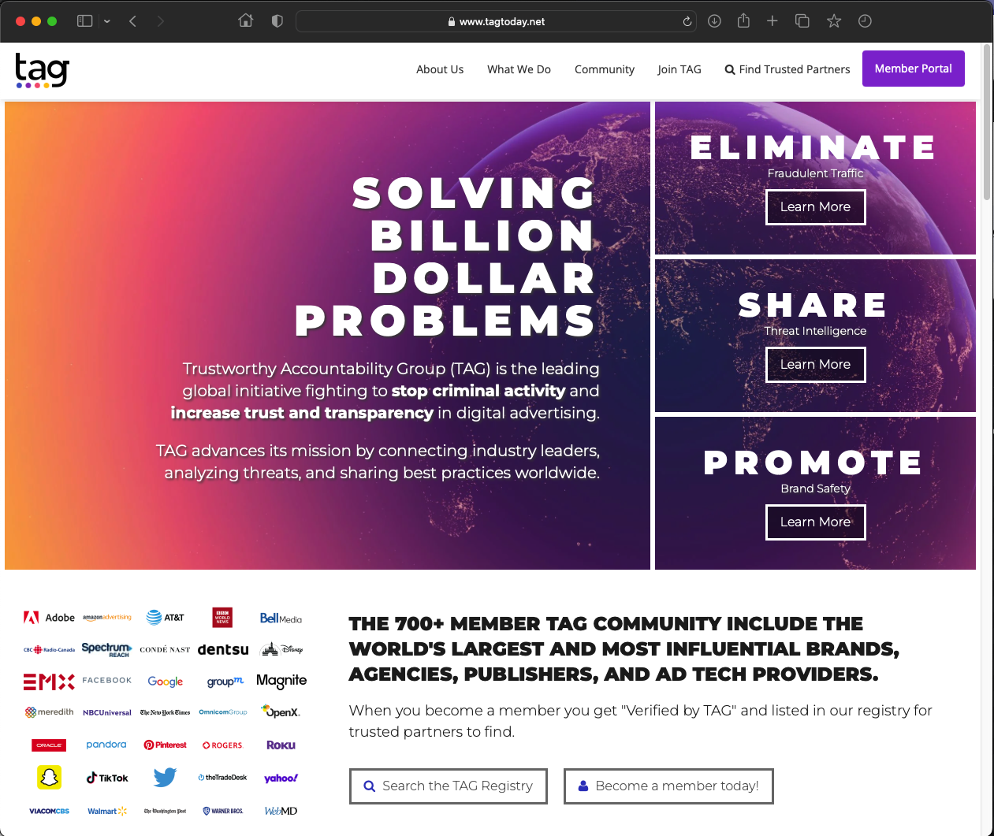
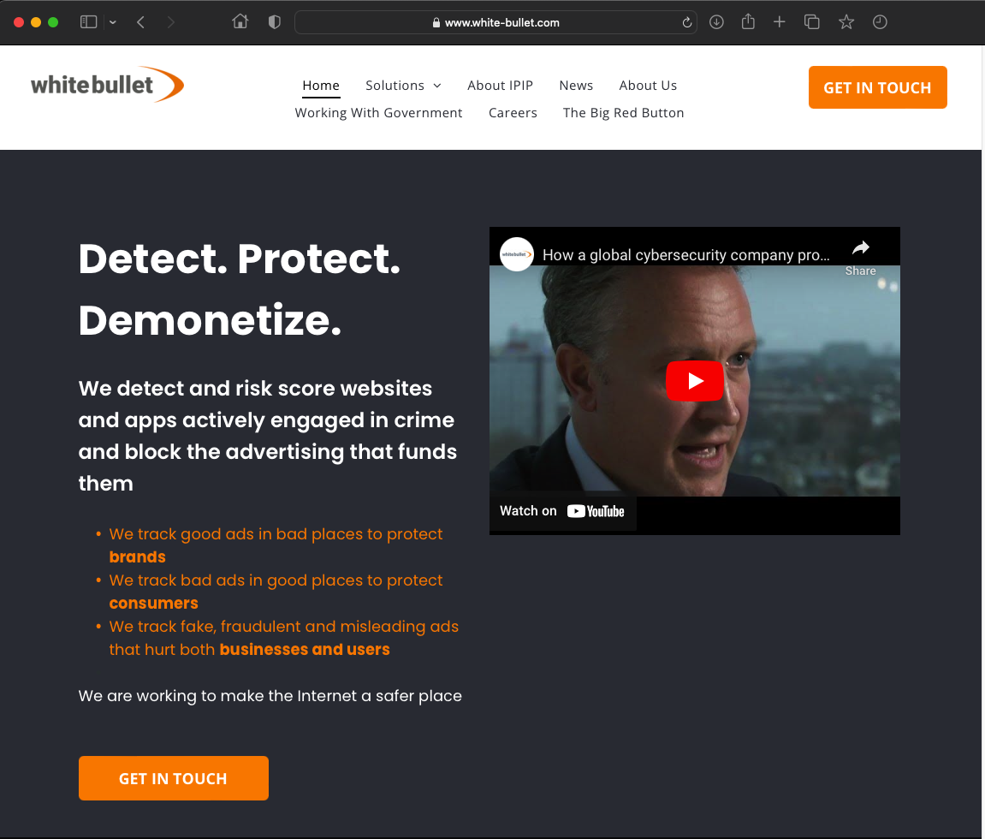
SESSION 5: THE USE OF INTERMEDIARY SERVICES IN IP INFRINGING ACTIVITIES
https://www.tagtoday.net
https://www.white-bullet.com

Slide 15
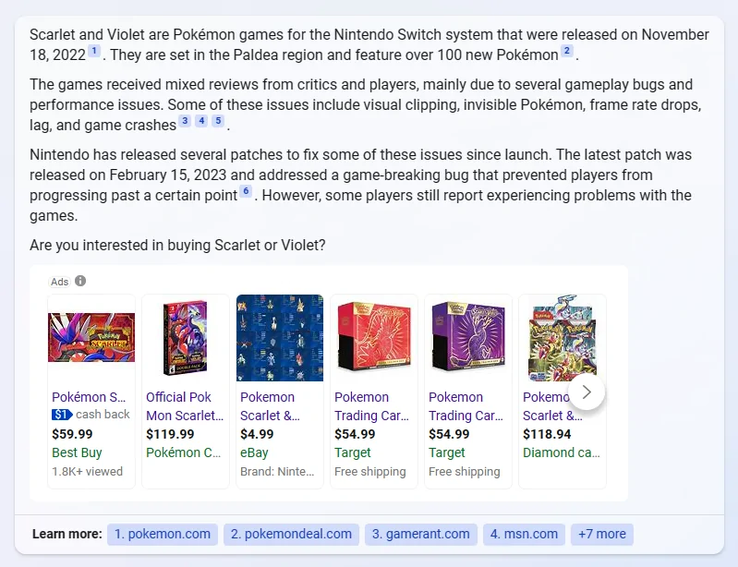
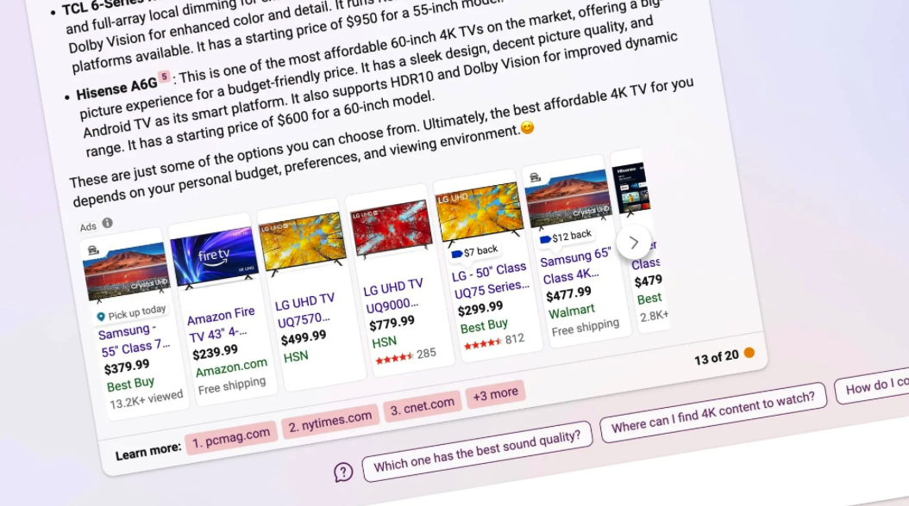
SESSION 5: THE USE OF INTERMEDIARY SERVICES IN IP INFRINGING ACTIVITIES
https://mspoweruser.com/this-is-what-the-bing-chatbot-responses-look-like-with-ads/
https://uk.pcmag.com/news/146197/prepare-to-see-more-ads-on-microsofts-ai-powered-bing-chat

Slide 16
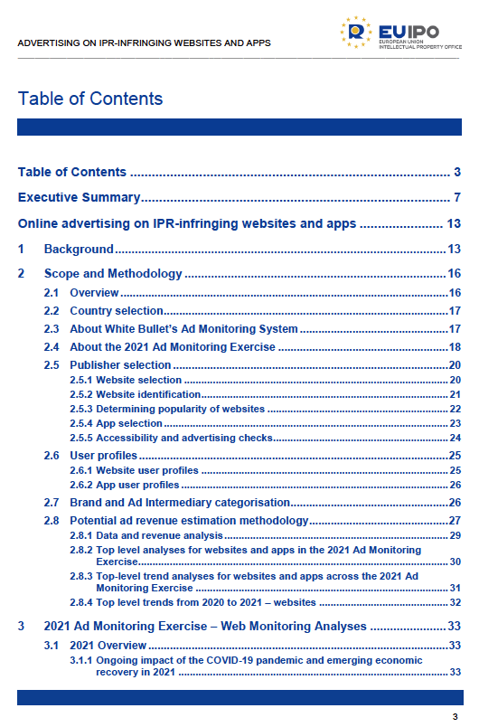
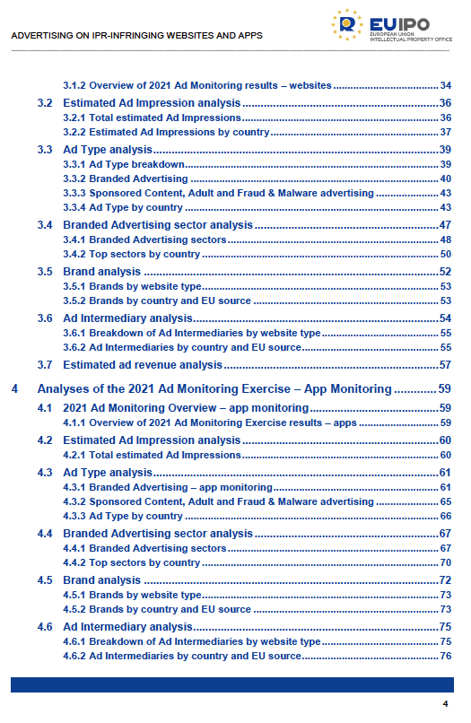
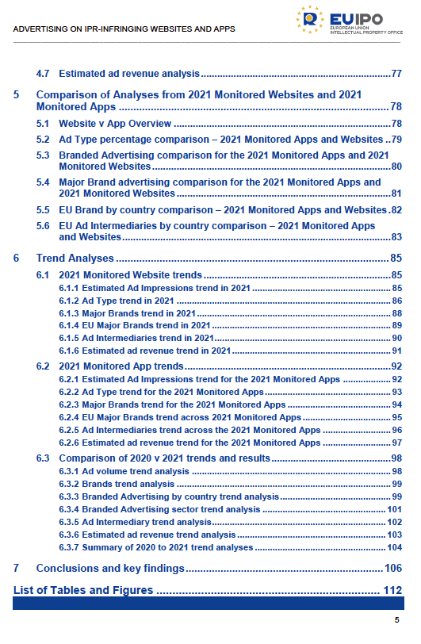
SESSION 5: THE USE OF INTERMEDIARY SERVICES IN IP INFRINGING ACTIVITIES
Online advertising on IPR-Infringing Websites and Apps 2021 https://euipo.europa.eu/tunnel-web/secure/webdav/guest/document_library/observatory/documents/reports/2022_Online_advertising_IPR_Infringing_Websites_and_Apps_2021/2022_Online_advertising_IPR_Infringing_Websites_and_Apps_2021_FullR_en.pdf

Slide 17
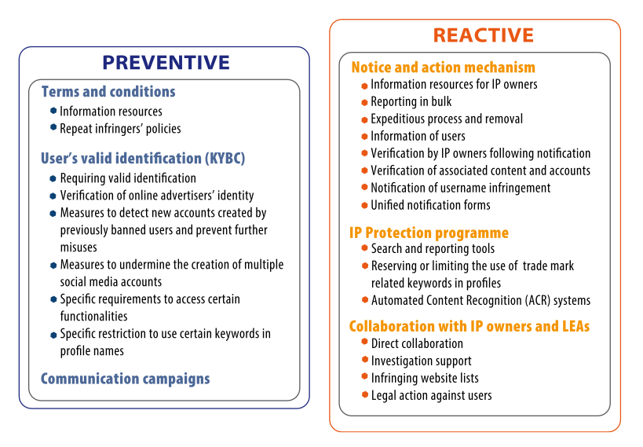
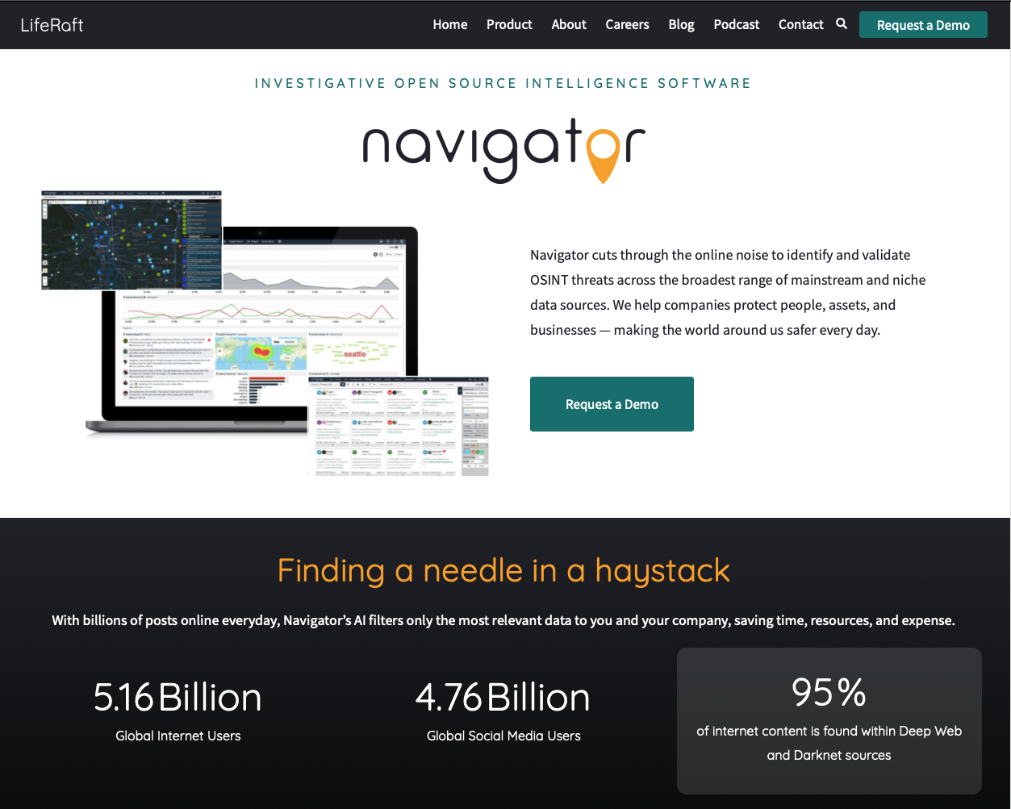
SESSION 5: THE USE OF INTERMEDIARY SERVICES IN IP INFRINGING ACTIVITIES
Policing social media
https://www.liferaftinc.com/
SOCIAL MEDIA – DISCUSSION PAPER New and existing trends in using social media for IP infringement activities and
good practices to address them https://euipo.europa.eu/tunnel-web/secure/webdav/guest/document_library/observatory/documents/reports/2021_Social_Media/2021_Social_Media_Discussion_Paper_FullR_en.pdf

Slide 18
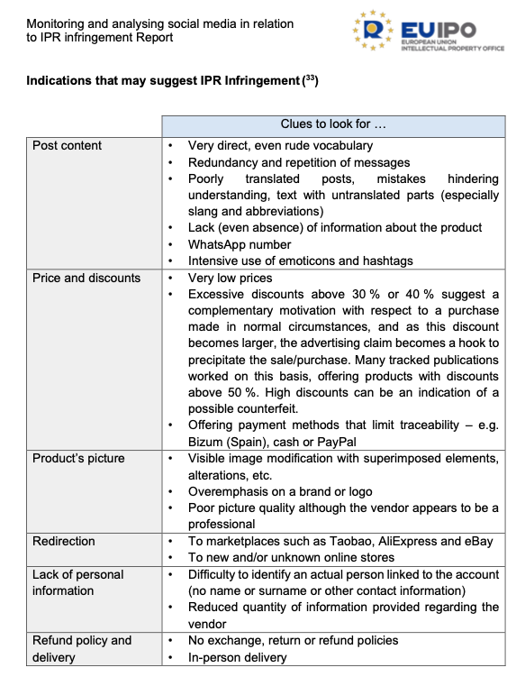
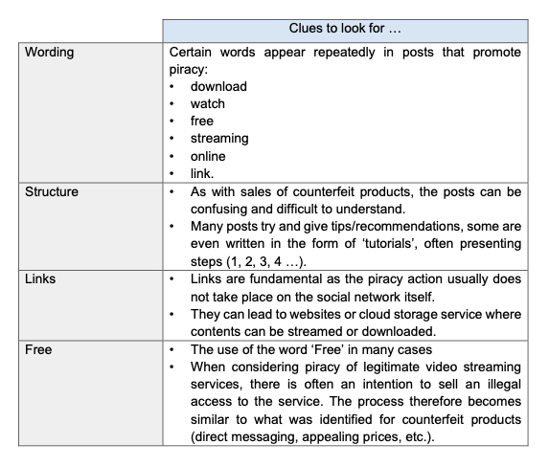
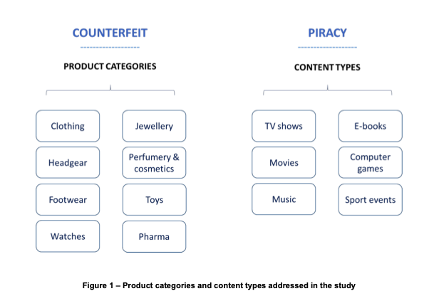
SESSION 5: THE USE OF INTERMEDIARY SERVICES IN IP INFRINGING ACTIVITIES
Policing social media
Monitoring and analysing social media in relation to IP infringement https://euipo.europa.eu/tunnel-web/secure/webdav/guest/document_library/observatory/documents/reports/2021_Monitoring_and_analysing_social_media_in_relation_to_IPR_Infringement_Report/2021_Monitoring_and_analysing_social_media_in_relation_to_IPR_Infringem

Slide 19
Q&A

