Slide 1
SPECIAL BRAND MANAGEMENT & IPR PROTECTION COURSE (Best Practices in Using New Technologies in IPR Enforcement) KRISTIAN NICO CALUGAY ACOSTA, Esq.

Slide 2
IPR ENFORCEMENT TECHNOLOGY (IPR ENFOTECH)
IPR Enfotech refers to the application of technology (online database, GPS systems, advanced cameras, product identification softaware, etc.) to help brand owners and law enforcement agencies during anti-counterfeiting operations.

Slide 3
IPR ENFOTECH STAGES
PRE-RAID OPERATIONS
ACTUAL RAID OPERATIONS
POST-RAID OPERATIONS

Slide 4
PRE-RAID ENFOTECH TOOLS & STRATEGIES
Online Market Surveillance
Onsite Market Surveillance

Slide 5
ONLINE MARKET SURVEILLANCE
Surveillance of Infringing Accounts, Posts and/or Stores on social media market places and e-commerce sites;
Digital cease and desist campaigns;
IPR enforcement coordination with the concerned social media and e-commerce platforms; and
Referral of targets for onsite market surveillance.

Slide 6
ONSITE MARKET SURVEILLANCE
Use of GPS systems and advanced cameras in the collation of evidence.
Example: GPSMapCamera App [required by the Bureau of Customs (BOC) under CMO No. 37-2021]

Slide 7
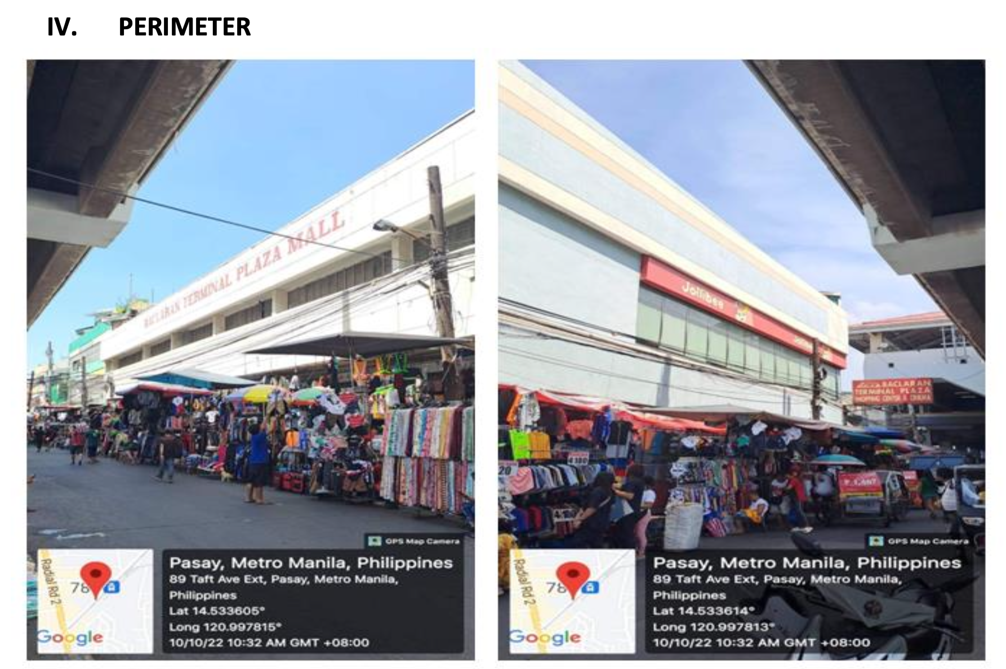
EXAMPLES (GPSMapCamera App)
Excerpt from an Actual Investigation Report Submitted to the BOC IPRD

Slide 8
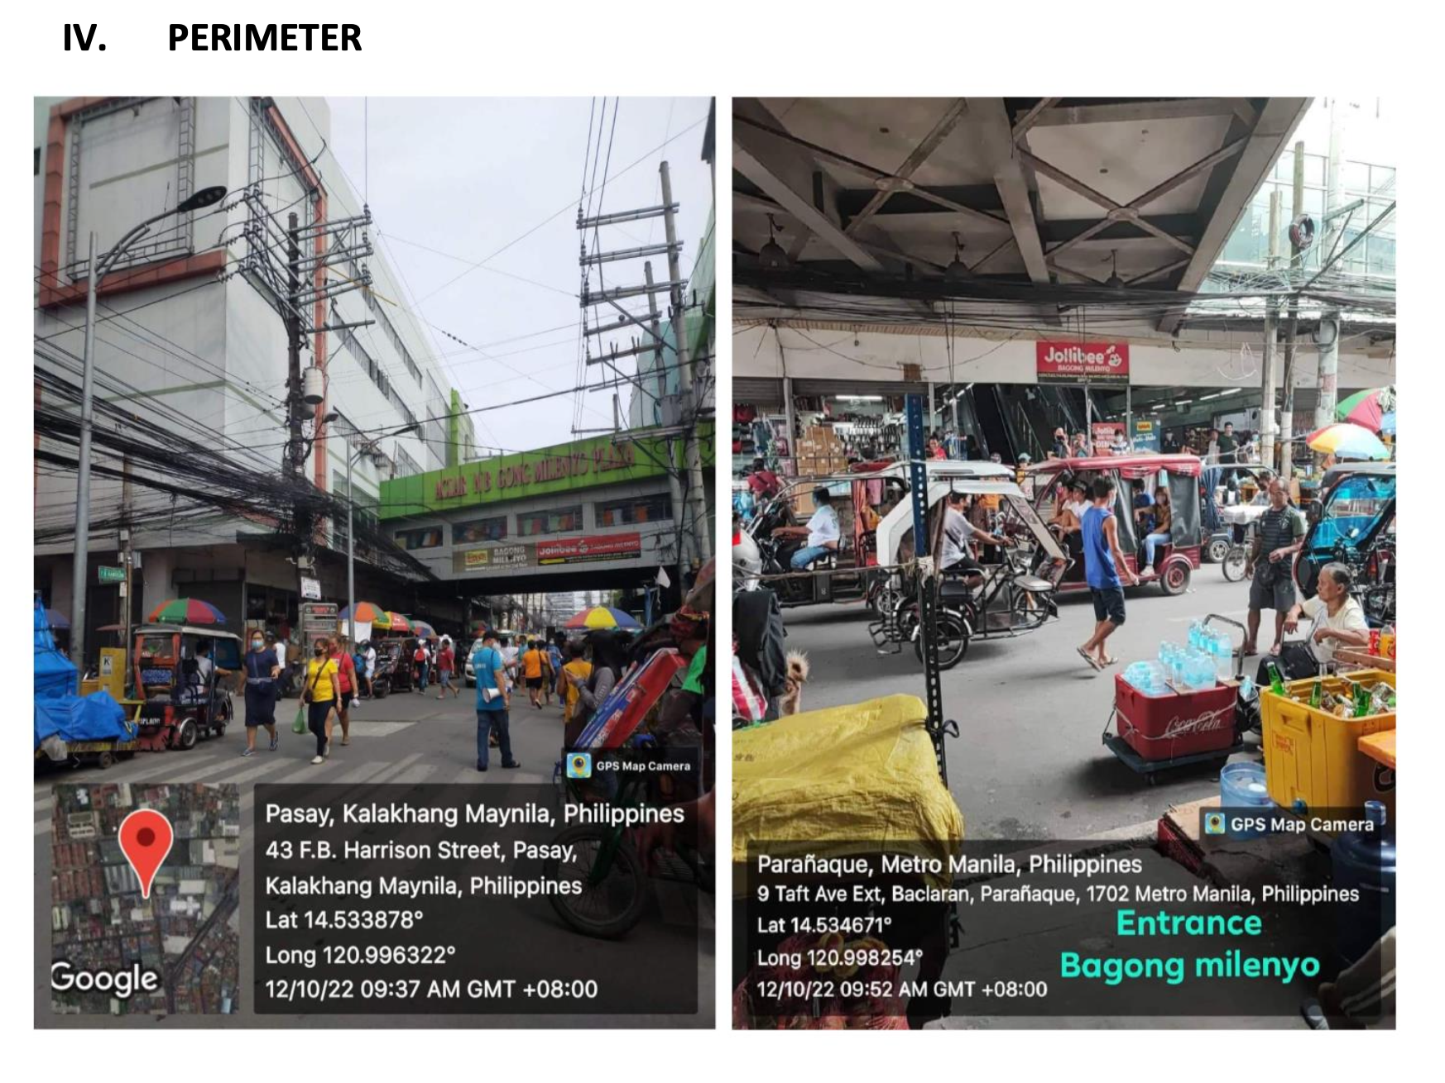
EXAMPLES (GPSMapCamera App)
Excerpt of from an Actual Investigation Report Submitted to the PNP – CIDG

Slide 9
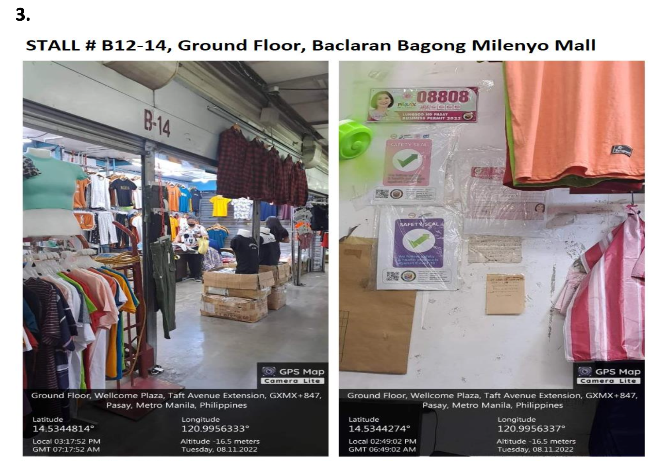
EXAMPLES (GPSMapCamera App)
Excerpt of from an Actual Investigation Report Submitted to the PNP – CIDG

Slide 10
ONSITE MARKET SURVEILLANCE
Use of Product Identification Software in examining the test-bought items. If the items are counterfeit, a certificate of non-authenticity will be issued by the brand owner and submit the same to the concerned law enforcement agency.
Example: APTOS Retail App currently use by GABC brands like Penshoppe.

Slide 11
ACTUAL RAID OPERATIONS
Use of GPS systems and advanced cameras in the collation of evidence.
Examples: Body-Worn Camera (BWC) or Alternative Recording Devices (ARD) under CMO No. 33-2021 for customs raids and BWC & ARD under A.M. No. 21-06-08-SC for enforcement actions of the NBI and the PNP.

Slide 12
ACTUAL RAID OPERATIONS
Use of Product Identification Software in examining the seized items. If the items are counterfeit, a certificate of non-authenticity will be issued by the brand owners and submit the same to the prosecution and judicial authorities.
Example: APTOS Retail App currently use by GABC brands like Penshoppe.

Slide 13
POST-RAID OPERATIONS
Authentication of IPR Enfotech evidence before the prosecution and judicial authorities.
PURPOSE: To successfully prosecute IPR violators in accordance with the Revised Rules of Procedure for IPR Cases (A.M. No. 10-3-10-SC) and the Revised Rules of Evidence (A.M. No. 19-08-15-SC)

Slide 14
AUTHENTICATING IPR ENFOTECH EVIDENCE
Documentary evidence like certificate of non-authenticity
Methods: Documents acknowledged before a notary public are authenticated by presenting the notarized document itself. For unnotarized documents, a document is authenticated when a party admits in record its existence or when a witness with personal knowledge confirms the execution, existence and authenticity of the document.

Slide 15
AUTHENTICATING IPR ENFOTECH EVIDENCE
Object evidence like photos taken and videos recorded using GPSMapCamera App, BWC or ARD.
Methods: Audio, photographic and video evidence are authenticated by showing, presenting or displaying them to the court and must be identified, explained or authenticated by the person who made the recording or by some other competent to testify on the accuracy thereof.

Slide 16
THANK YOU!!!

