Slide 1
BEST PRACTICE IN USING TECHNOLOGIES IN IPR ENFORCEMENT
PLTCOL JAY D GUILLERMO
Acting Chief, CRU-PNP ACG
Notes:
Information Briefing

Slide 2
SEQUENCE OF PRESENTATION
MISSION and FUNCTIONS
CYBERCRIME DEFINED
USE OF TECHNOLOGIES IN IPR VIOLATIONS (CASE STUDIES)
CHALLENGES
RECOMMENDATIONS
RESULTS

Slide 3
MISSION
Implement and enforce pertinent laws on cybercrime and other cyber related crimes and pursue an effective anti-cybercrime campaign.

Slide 4
FUNCTIONS
Investigate all cybercrimes and other crimes in which Information and Communications Technology (ICT) was used in the commission of criminal acts or the object of attack;
Conduct data recovery and forensic analysis on all computers, computer peripherals and storage devices, and other digital evidences seized by PNP units and any other law enforcement agencies within the country;
Conduct vulnerability assessment on the security of Information and Communications Technology (ICT) in both public and private IT infrastructures;
Provide technical investigative support to various law enforcement agencies, both local and international, against cyber-enabled criminality.

Slide 5
FUNCTIONS
Maintain an intelligence database of various underground blogs, web forums, chat rooms and other platforms being utilized by various organized criminal groups;
Establish and maintain a modern digital forensic laboratory;
Conduct continuous specialized trainings and seminars, in coordination with the PNP Training Service on anti-cybercrime operations;
Maintain linkages with different PNP offices, local government agencies, other government agencies on matters pertaining to anti-cybercrime operations; and
Perform other tasks as directed by the Chief, PNP

Slide 6
CYBERCRIME DEFINED
All crimes defined and penalized by the Revised Penal Code, as amended, and special laws, if committed by, through and with the use of Information and Communications Technologies.

Slide 7
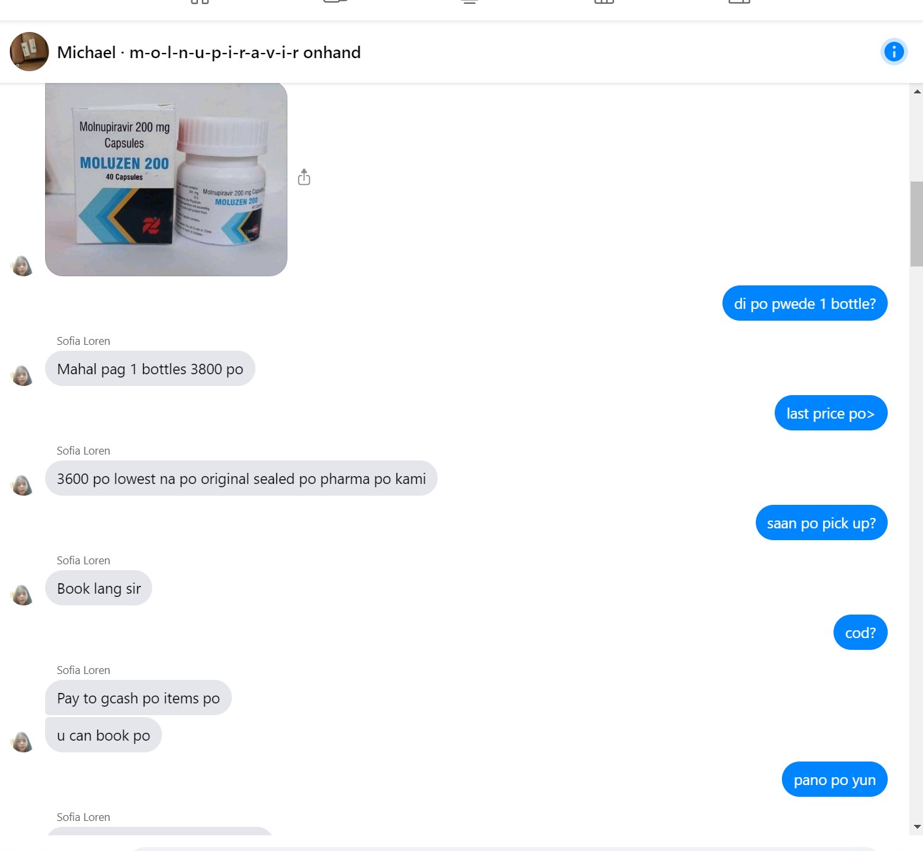
USE OF TECHNOLOGIES IN IPR VIOLATIONS (CASE STUDIES)
FACEBOOK MARKET
TELEGRAM
FB MESSENGER
USE OF CELLULAR PHONES
ONLINE APPLICATIONS

Slide 8
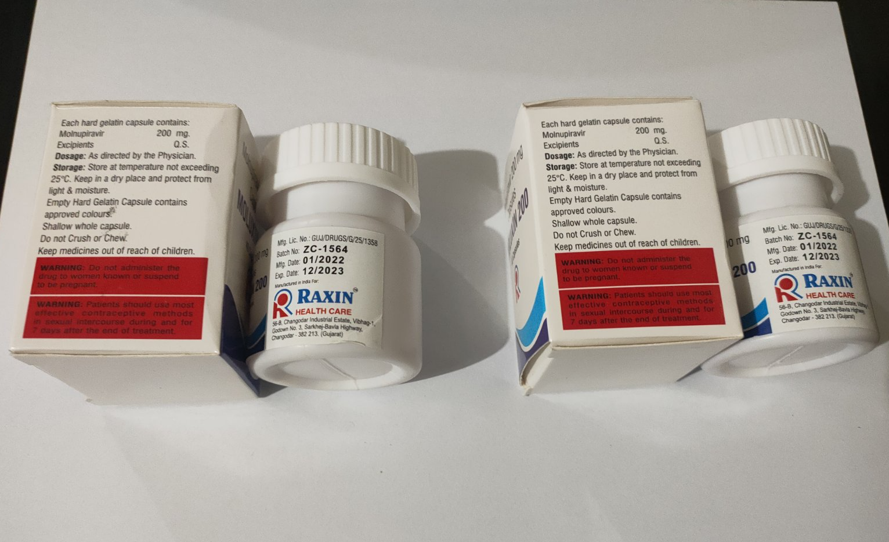
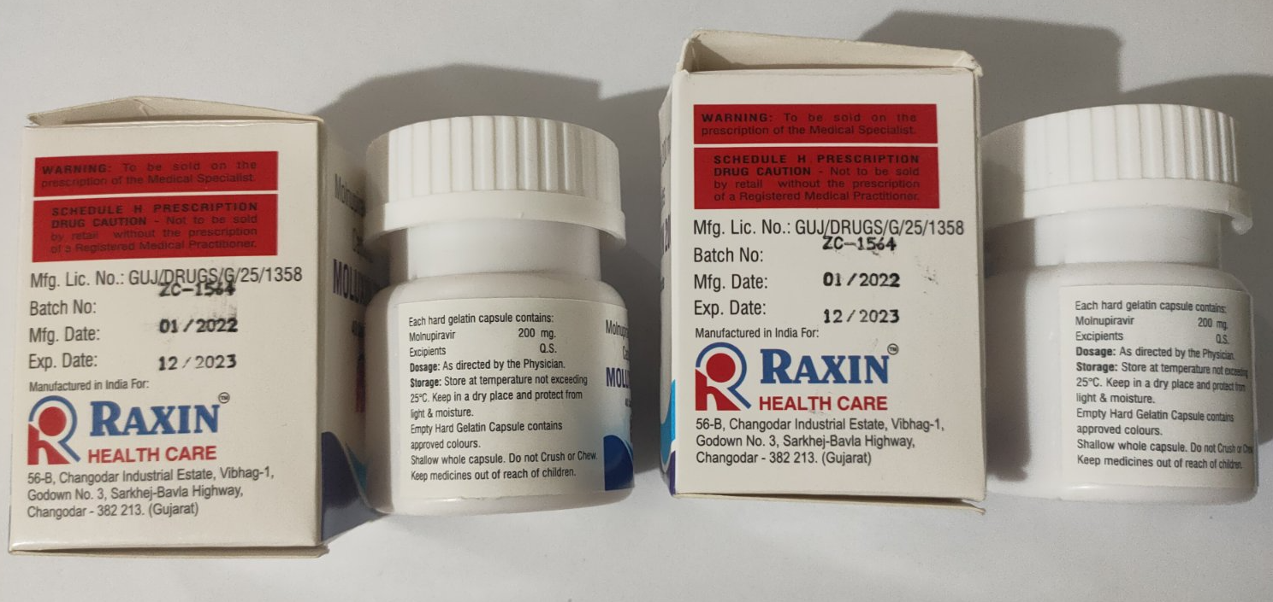
CASE STUDY 1
ONLINE SELLING OF MOLNUPIRAVIR
FDA coordinated on the selling of COVID-19 Medicines
Rampant selling of unregistered Medicine in social media platform specifically Molnupiravir.

Slide 9
CASE STUDY 1
On April 6, 2022
Cyber patrolling on the link (https://www.facebook.com/marketplace/item/aaaaaaaaaaaaaa)
Product Verification Certificate from FDA with post title “m-o-l-n-u-p-i-r-a-v-i-r on hand”
Identified Ms S with Facebook id aaaaaaaaaaaaaaaaa
Used the cellphone number 0950xxxxxxx to discussed the method of transaction.
On April 18, 2022
Transacted to Ms. S on the said link
Test buy one (1) box with Forty (40) capsules of Moluxin 200 (Molnupiravir) worth three thousand pesos (Php 3,000.00)
Used GCASH with number 0950xxxxxxx
Delivered via Lalamove.

Slide 10
CASE STUDY 1
On April 28, 2022
Another transaction to Ms. S for ten (10) boxes of Moluxin 200 (Molnupiravir)
Amounting to nineteen thousand pesos (Php 19,000.00)
To be delivered on the following week
On May 1, 2022
Ten (10) boxes of Moluxin 200 (Molnupiravir) was ready for shipment
Six (6) boxes of Moluxin 200 (Molnupiravir) was only ordered for delivery

Slide 11
CASE STUDY 1
On May 3, 2022
Confirmed the order of the Moluxin 200 (Molnupiravir)
To be delivered on May 4, 2022.
On May 4, 2022
Entrapment operations
Seller shipped the six (6) boxes of Moluxin 200 (Molnupiravir)
The delivery driver was identified and arrested

Slide 12
CASE STUDY 1
CASE FILED
Section 11 (a), (j), and (k) of RA 3720 as amended by RA 9711 otherwise known as "Food and Drug Administration (FDA) Act of 2009" in relation to Sec. 6 of R.A. 10175 otherwise known as “Cybercrime Prevention Act of 2012 against:
1. Delivery Driver (Arrested); and
2. Online seller (At Large).

Slide 13
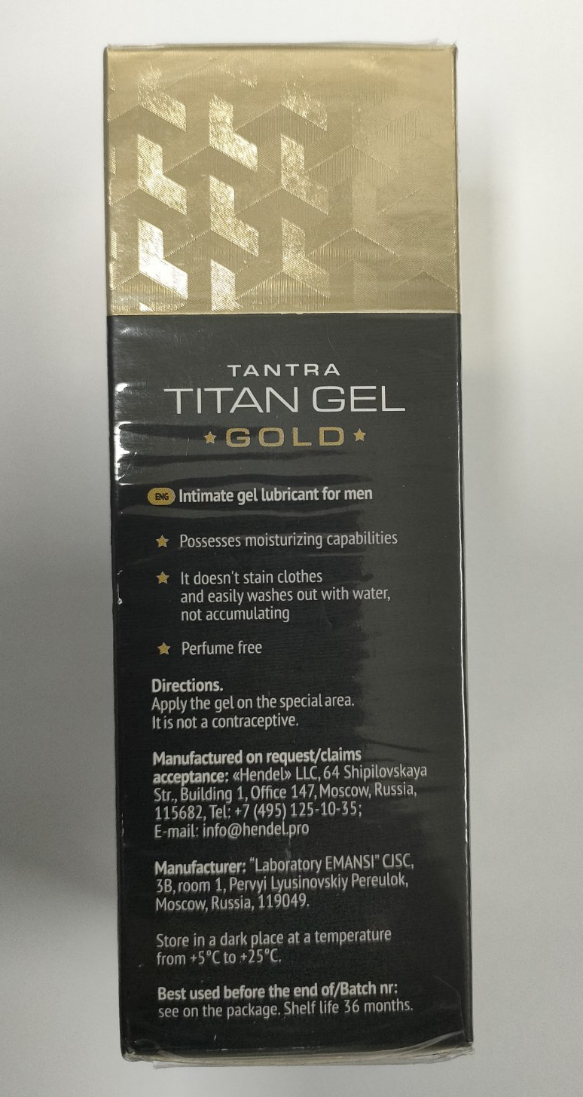
CASE STUDY 2
ONLINE SELLING OF TITAN GEL
Walk in informant
Selling of Fake TITAN GEL

Slide 14
CASE STUDY 2
On January 17, 2023
Conduct of cyber patrolling on Facebook
Identified Facebook URL https://www.facebook.com/xxxxxxx and FB ID: yyyyyyyyyy
On January 18, 2023
IOC posed as Poseur Buyer
Initiated a conversation on the Facebook
Asked the product if available and amount

Slide 15
CASE STUDY 2
On January 17, 2023
Conduct of cyber patrolling on Facebook
Identified Facebook URL https://www.facebook.com/xxxxxxx and FB ID: yyyyyyyyyy
On January 18, 2023
IOC posed as Poseur Buyer
Initiated a conversation on the Facebook
Asked the product if available and amount
Agreed for transaction
Identified the pickup point
Delivered the product using J&T courier

Slide 16
CASE STUDY 2
On January 27, 2023
Request for verification and certification for the product “Titan Gel Gold” to FDA
FDA certified that the “Titan Gel Gold” is not registered/notified medical device with the Center for Device Regulation, Radiation Health, and Research (CDRRHR).
On April 11, 2023
Initiated a conversation on the Facebook account of the seller
Asked the product if available and amount

Slide 17
CASE STUDY 2
On April 12, 2023
Entrapment operations
IOC Messaged again the same Facebook account of the seller
Stated if he can pick up the product
The product will be delivered by his personal delivery rider at the pickup point
The driver was arrested and confiscated the fake product on his possession

Slide 18
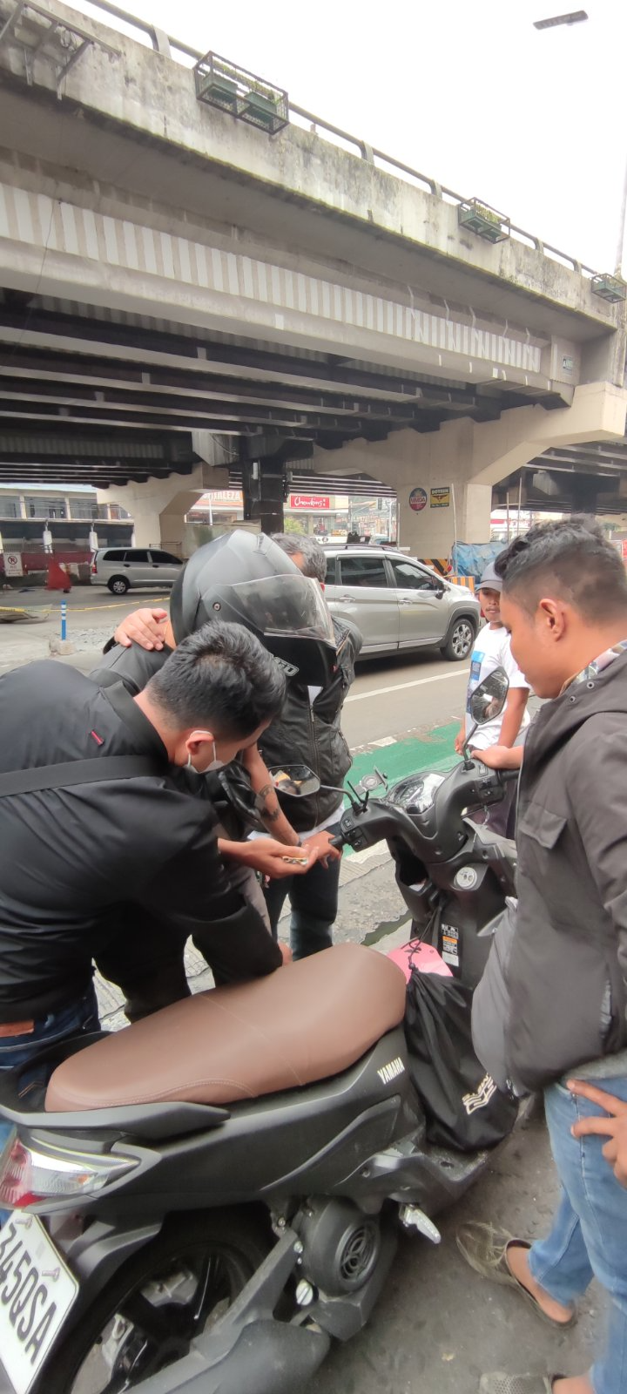
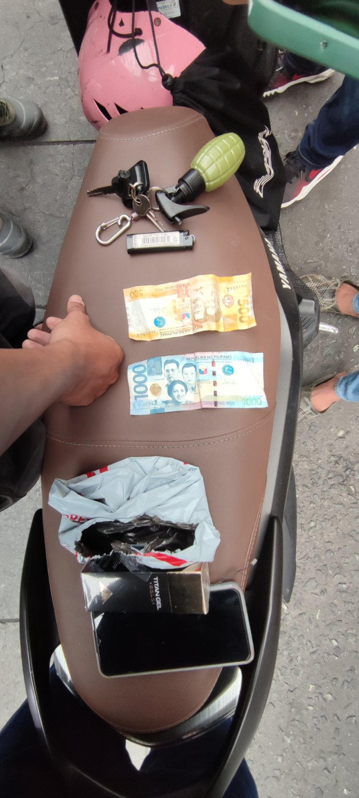
CASE STUDY 2
CASE FILED
Section 11 (a), (j), and (k) of RA 3720 as amended by RA 9711 otherwise known as "Food and Drug Administration (FDA) Act of 2009" in relation to Sec. 6 of R.A. 10175 otherwise known as “Cybercrime Prevention Act of 2012 against:
1. Delivery Driver (Arrested); and
2. Online seller (At Large).

Slide 19
CHALLENGES
AVAILABILITY OF BRAND OWNERS
CERTIFICATION FROM GOVERNMENT AGENCIES
INTERPRETATION ON APPLICABLE LAWS DURING THE ARREST
ONE AGENCY APPROACH

Slide 20
RECOMMENDATIONS
CONTINOUS EDUCATION
BUILDING TRUST
PARTNERSHIPS

Slide 21
RESULTS
CONTINOUS EDUCATION
ENHANCEMENT OF KNOWLEDGE
SHARED EXPERIENCES
KNOWING THE ENEMY

Slide 22
RESULTS
BUILDING TRUST
SHARING OF INFORMATION
EASY COMMUNICATION
WEAKENING THE ENEMY

Slide 23
RESULTS
PARTNERSHIPS
PREVENTION
INVESTIGATION
PROSECUTION

Slide 24
THANK YOU
Notes:
End of Presentation.

