Slide 1
Day 1 Session 2 Intermediary Services and IP Crimes
Pascal Hetzscholdt | Manila | 27-28 April 2023

Slide 2
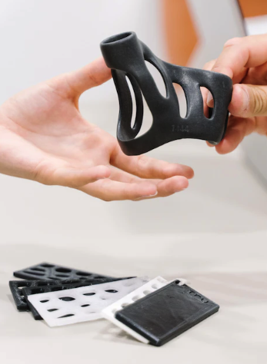
SESSION 2: NEW AND EMERGING TECHNOLOGIES: OPPORTUNITIES AND DRIVERS
3D PRINTING
FROM FRAGILE TO ‘BETTER THAN ‘THE REAL THING’
TRACKING AND TRACING, DRM, SECURE CAD FILES
REDUCED WASTE: TRANSPORTATION, LOCAL PRODUCTION
BETTER, STRONGER DESIGNS, TAILORED
NEW MATERIALS: BETTER PROTECTION FOR LAW ENFORCEMENT
MONITORING OF DEVELOPMENTS HIGHLY RECOMMENDED: EXPERTISE IS SCARCE
CHEMICAL MARKERS: AUTHENTICITY, ORIGIN
EDUCATION AND OUTREACH TO MANUFACTURERS RECOMMENDED

Slide 3
SESSION 2: NEW AND EMERGING TECHNOLOGIES: OPPORTUNITIES AND DRIVERS
Countless
innovations
Source: Google Images

Slide 4
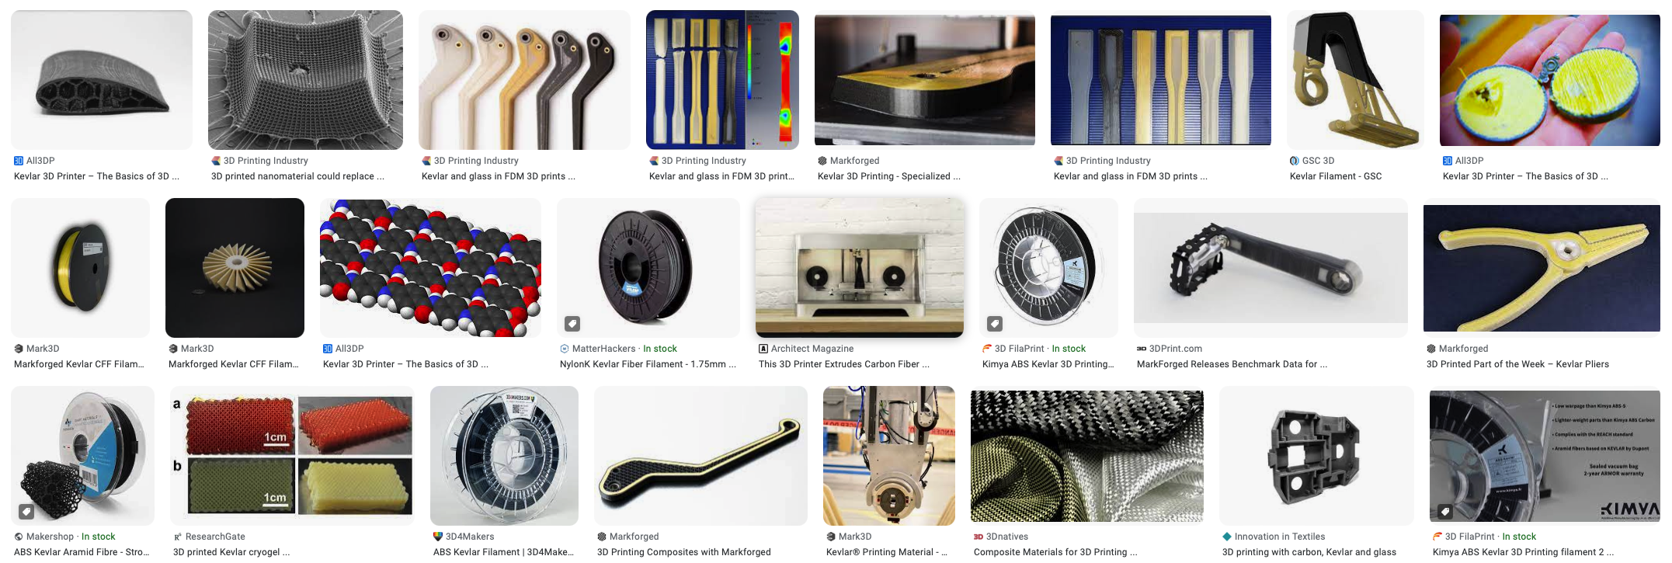
SESSION 2: NEW AND EMERGING TECHNOLOGIES: OPPORTUNITIES AND DRIVERS
Stronger tools and stronger materials (also for policing)
Source: Google Images

Slide 5
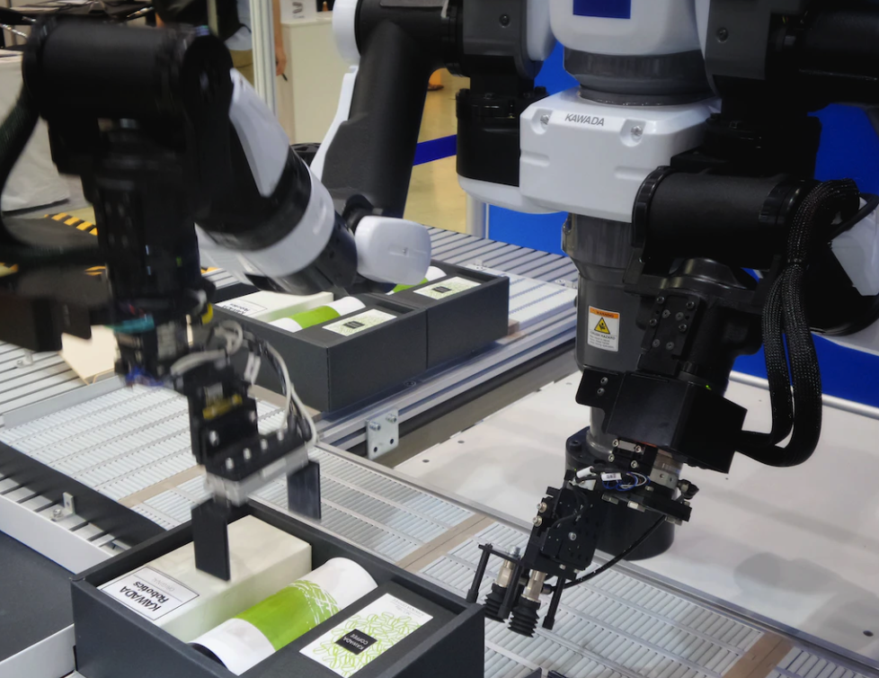
SESSION 2: NEW AND EMERGING TECHNOLOGIES: OPPORTUNITIES AND DRIVERS
NANOTECH
ROBOTS AT A MOLECULAR SCALE, CLEANING UP POLLUTION
INFORMATION CARRIERS, FASTER AND SMALLER TECH
INTELLIGENT AND SMART GOODS, EVEN SOLAR AND FUEL CELLS
LABELLING OF AUTHENTIC GOODS
BETTER MEDICAL DIAGNOSES
SELF-REPAIRING MATERIALS
THEFT RESISTANCE AND MONITORING
COMMS AND EVIDENCE TRANSPORTATION

Slide 6
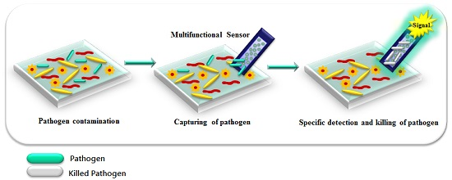
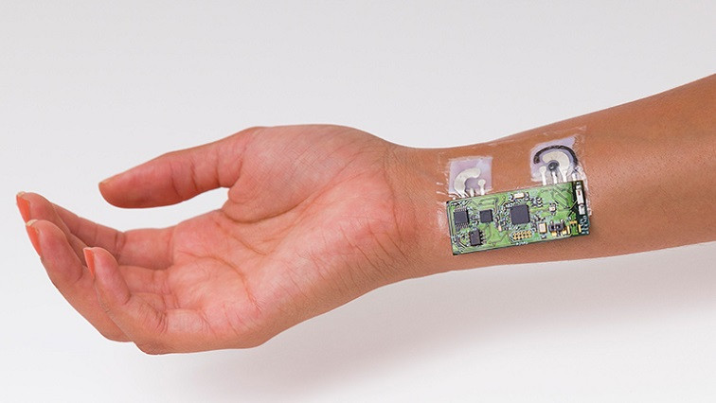
SESSION 2: NEW AND EMERGING TECHNOLOGIES: OPPORTUNITIES AND DRIVERS
https://statnano.com/news/67961/The-Nanotechnology-Breakthrough-with-Potential-Significance-for-Biomedical-Sensors
https://www.mdpi.com/1424-8220/17/9/2121
Many breakthroughs in downscaling tech. Sensor technology

Slide 7
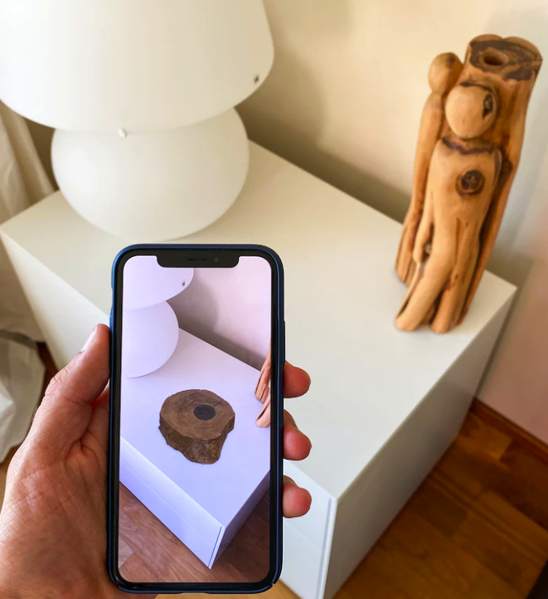
SESSION 2: NEW AND EMERGING TECHNOLOGIES: OPPORTUNITIES AND DRIVERS
AR, VR
TRAINING
INVESTMENT (APPLE, MS, GOOGLE, AMAZON, META, NVIDIA, TENCENT, EPIC, ROBLOX, ADOBE, UNITY, UNREAL, SONY, HTC, VALVE…) CENTRALIZATION EASIER FOR OUTREACH BY LAW ENFORCEMENT?
LONG-TERM INVESTMENT FOR BUSINESSES
GDPR, BIOMETRICS, PSYCHOLOGICAL FINGERPRINTS OFFER NEW OPPORTUNITIES FOR POLICING
ENHANCED SITUATIONAL AWARENESS – MULTIPLE DATA FEEDS – DATA MINING.
REDUCED RESPONSE TIMES? REMOTE WORKING?

Slide 8
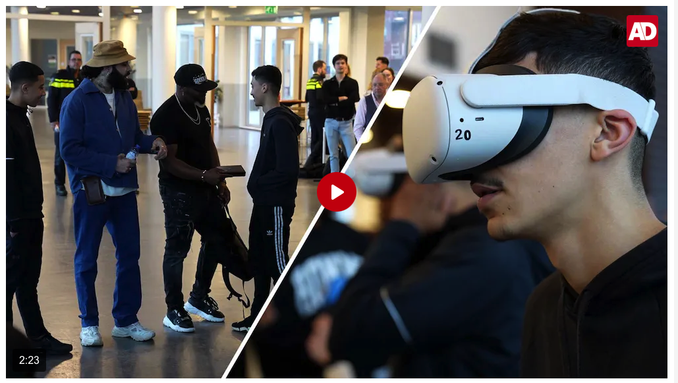
SESSION 2: NEW AND EMERGING TECHNOLOGIES: OPPORTUNITIES AND DRIVERS
VR glasses show young people the risks of drug crime
March 9, 2023
The police and the municipality of Rotterdam started a pilot on Wednesday called 'Cocaine Collectors' (CoCo). With the help of VR glasses, they try to protect vulnerable young people at schools in South Rotterdam from a life as drug sniffers in the port of Rotterdam.
https://www.ad.nl/video/productie/vr-bril-toont-jongeren-de-risico-s-van-drugscriminaliteit-362196

Slide 9
SESSION 2: NEW AND EMERGING TECHNOLOGIES: OPPORTUNITIES AND DRIVERS
BLOCKCHAIN & WEB3
BLOCKCHAIN, NFT, WEB3
OWNERSHIP, RIGHTS MANAGEMENT
COSTS OF REGISTRATION
FULL TRANSPARENCY, KYC, KYBC
HUMAN FACTOR
OPPORTUNITIES FOR INVESTIGATIONS
IMPROVED SECURITY FOR DATA TRANSMISSION
TASK AUTOMATION
VERIFICATION OF DATA ACCURACY
BETTER IDENTIFICATION OF OFFICERS (AND SUSPECTS)

Slide 10
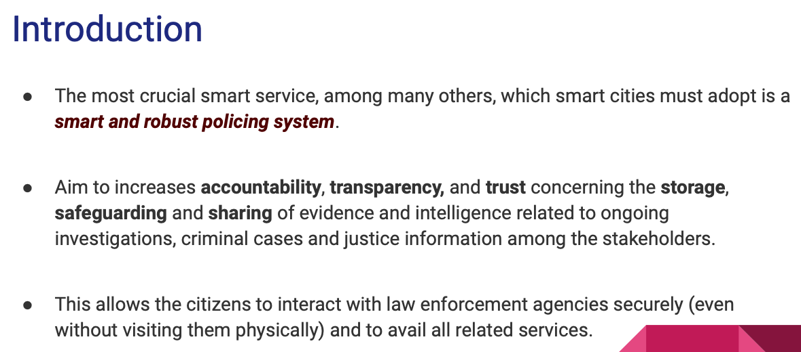
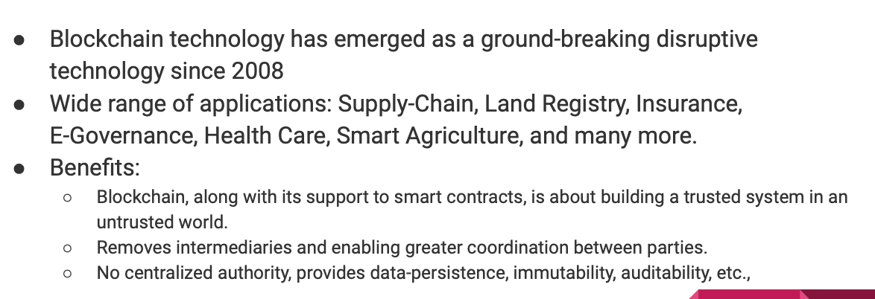
SESSION 2: NEW AND EMERGING TECHNOLOGIES: OPPORTUNITIES AND DRIVERS
https://sinconf.org/sin2020/docs/4.pdf

Slide 11
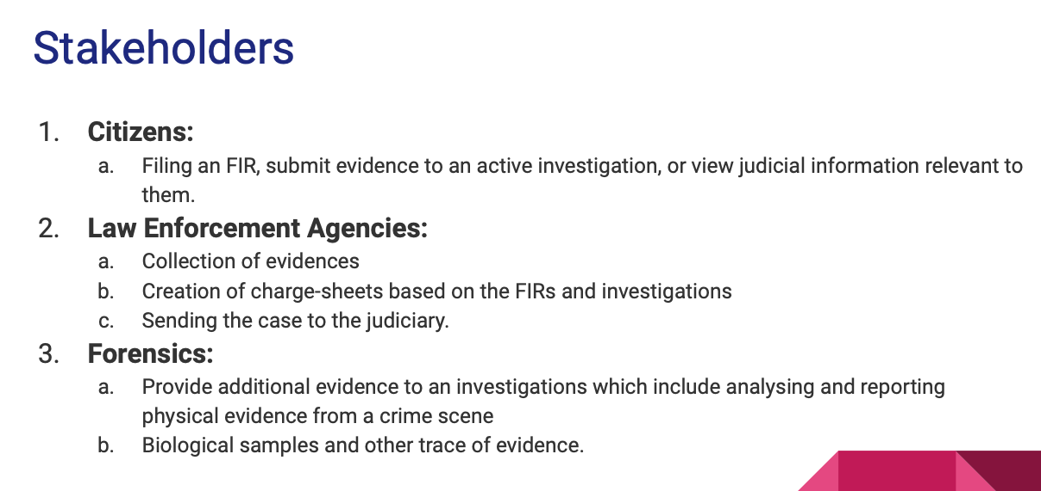
SESSION 2: NEW AND EMERGING TECHNOLOGIES: OPPORTUNITIES AND DRIVERS
https://sinconf.org/sin2020/docs/4.pdf

Slide 12
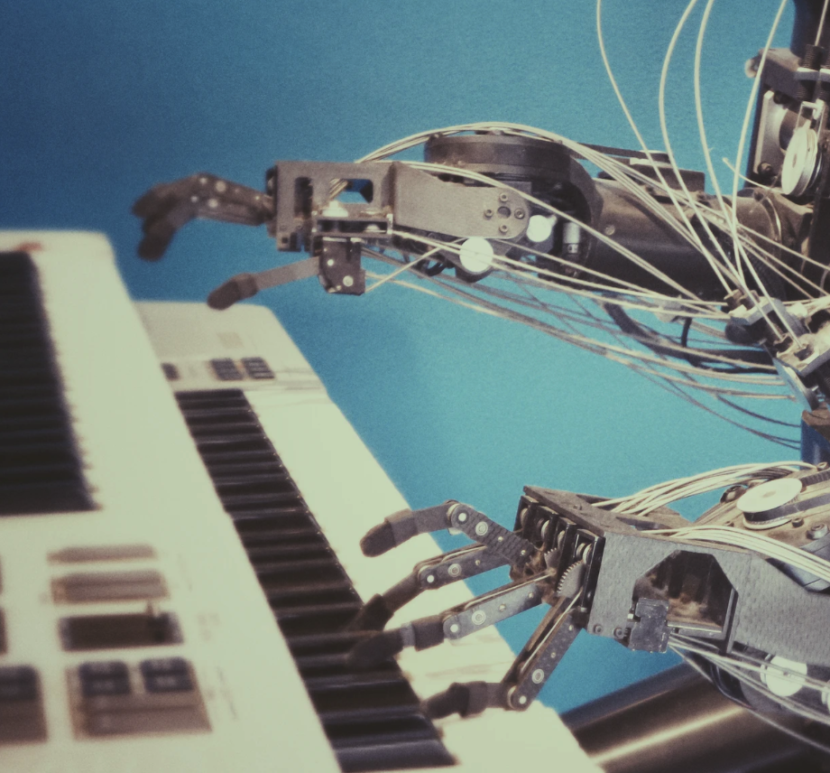
SESSION 2: NEW AND EMERGING TECHNOLOGIES: OPPORTUNITIES AND DRIVERS
ARTIFICIAL INTELLIGENCE & ROBOTICS
TRAINING AND EDUCATION
MINIMIZING TRAVEL (SUSTAINABILITY)
COMBINATION WITH ROBOTICS
DRONES 2.0
RESPONSE TIMES AND PUBLIC SAFETY
TRAFFIC SITUATION AND DATA COLLECTION
EVIDENCE TRANSPORTATION
SELF ASSESSMENTS AND ACCOUNTABILITY
CRIME PREVENTION (PREDICTIONS/PATTERNS)

Slide 13
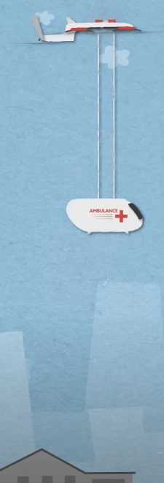
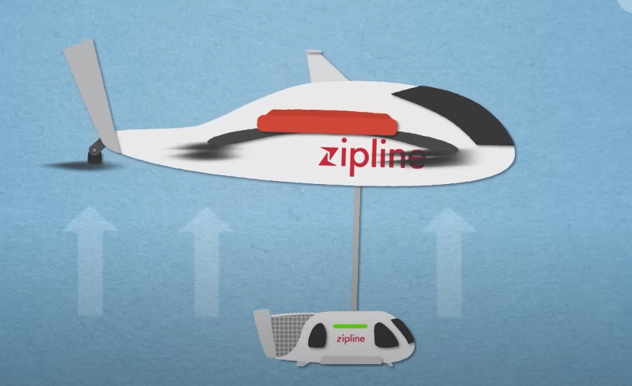
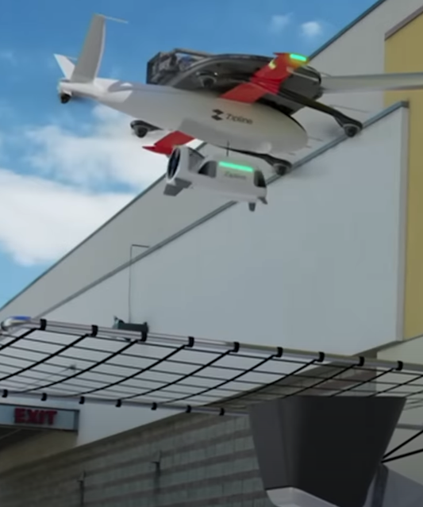
SESSION 2: NEW AND EMERGING TECHNOLOGIES: OPPORTUNITIES AND DRIVERS
Amazing Invention- This Drone Will Change Everything https://www.youtube.com/watch?v=DOWDNBu9DkU

Slide 14
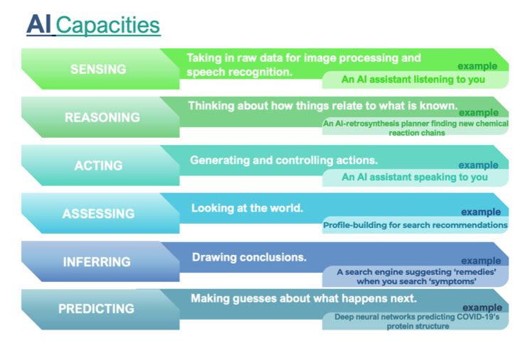
SESSION 2: NEW AND EMERGING TECHNOLOGIES: OPPORTUNITIES AND DRIVERS
CHATGPT VS GOOGLE BARD VS BING CHAT
PERSON VS SEARCH VS LIMITED TOOL
MATURITY – INEXPERIENCED
ROBUSTNESS – COMPLEXITY PROMPTS
NAMING AND SHAMING – AWARENESS - APOLOGY
INTERPRETATION OF QUESTIONS - CONTEXT
DESIRES – ADVERTISING & ECOSYSTEM
RESTRICTIONS AND LIABILITY
TRAINED ‘NOT TO ANSWER’
BIAS (TOOL VS USE)
PRIOR KNOWLEDGE MAKES ALL THE DIFFERENCE
DATA USE AND DATA LEAKS, FEEDBACK LOOPS, HUMAN MODERATORS
Study on the Impact of Artifical Intelligence on the Infringement and Enforcement of Copyright and Designs https://euipo.europa.eu/tunnel-web/secure/webdav/guest/document_library/observatory/documents/reports/2022_Impact_AI_on_the_Infringement_and_Enforcement_CR_Designs/2022_Impact_AI_on_the_Infringement_and_Enforcement_CR_Designs_FullR_en.pdf

Slide 15
Q&A

