Slide 1
Day 1 Session 1 New & Emerging Technologies
Pascal Hetzscholdt | Manila | 27-28 April 2023

Slide 2
INTRODUCTION
Dutch National Police - Cybercrime
Movie studios & broadcasters
Industry Association
Technology vendors
Wiley
Pascal Hetzscholdt
Senior Director, Content Protection
phetzschol@wiley.com

Slide 3
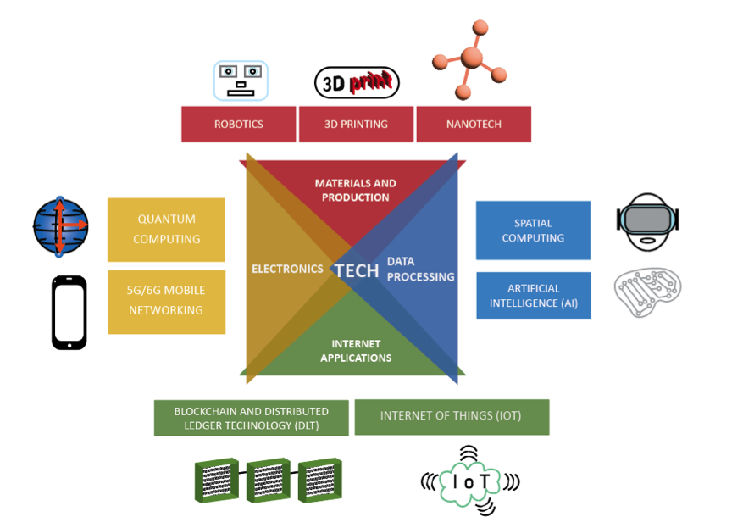
INTRODUCTION: TECHNOLOGY AS A DOUBLE-EDGED SWORD
PROS: IP PROTECTION INNOVATION IDENTIFICATION REGISTRATION
CONS: IP INFRINGEMENT DISRUPTION THEFT COUNTERFEITING
Intellectual Property Infringement and Enforcement Tech Watch Discussion Paper 2023 https://euipo.europa.eu/tunnel-web/secure/webdav/guest/document_library/observatory/documents/reports/2023_IP_Tech_Watch_Discussion_Paper/2023_IP_Infringement_and_Enforcement_Tech_Watch_Discussion_Paper_FullR_en.pdf

Slide 4
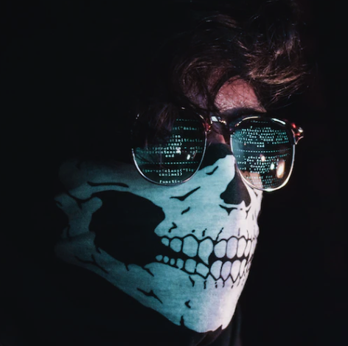
SESSION 1: NEW AND EMERGING TECHNOLOGIES: THREATS AND CHALLENGES FOR IP
HISTORICAL BACKGROUND
HACKERS & CYPHERPUNKS, MANIFESTOS AND DECLARATIONS: ANTI-GOVERNMENT SENTIMENTS
BUSINESSES BREAKING THINGS: DISRUPTION OF THE STATUS QUO
LOVE/HATE RELATIONSHIP WITH GOVERNMENTS
FREEDOM OF EVERYTHING, UNLESS IT’S NOT IN MY INTEREST
MORE DATA (TRAFFIC) AND LESS REGULATION EQUALS MORE ADS, SUBSCRIPTIONS, DEVICES, STORAGE AND BANDWIDTH: MORE MONEY
FUTURE OF FULL TRANSPARENCY (FOR EVERYBODY): PRIVACY ISSUES
FUTURE OF NO ENCRYPTION: SECURITY ISSUES
FUTURE OF AUTOMATION OF ENFORCEMENT (OF COMPLIANCE)? THIS WILL BE NEEDED FOR LAW ENFORCEMENT!

Slide 5
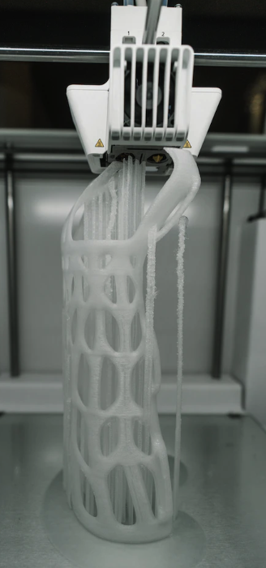
SESSION 1: NEW AND EMERGING TECHNOLOGIES: THREATS AND CHALLENGES FOR IP
3D PRINTING
FROM EXPERIMENTAL TO RETAIL: THE 3D PRINTED PRODUCT IS SUPERIOR!
FROM FRAGILE TO ‘BETTER THAN ‘THE REAL THING’: SAFETY ISSUES
DANGEROUS PRECURSORS (OR COMBINATIONS THEREOF): CHEMICALS, SUSTAINABILITY ISSUES
COUNTERFEITING / COPYRIGHT, TRADEMARK & PATENT INFRINGEMENT: ONE WANTS TO PRINT WHAT ONE ALREADY KNOWS.
MONITORING OF DEVELOPMENTS HIGHLY RECOMMENDED
YOU CANNOT REGULATE WHAT YOU DON’T KNOW OR ANALYZE
LACK OF EDUCATION: WHO IS DOWNLOADING THE FILES TO PRINT GUNS?
LIMITATIONS TO OVERSIGHT DUE TO LOCAL PRODUCTION OF PRECURSORS: THE MATERIALS TO PRINT ARE HARMLESS, THE END RESULTS ARE NOT. EXAMPLE: UNDETECTABLE GUNS, REPEATING CROSSBOWS, CATAPULTS

Slide 6
SESSION 1: NEW AND EMERGING TECHNOLOGIES: THREATS AND CHALLENGES FOR IP
Source: Google Images

Slide 7
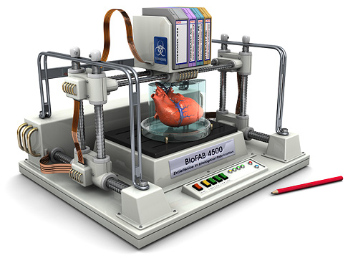
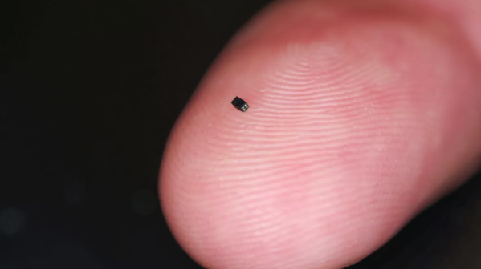
SESSION 1: NEW AND EMERGING TECHNOLOGIES: THREATS AND CHALLENGES FOR IP
https://www.explainingthefuture.com/bioprinting.html
https://www.digitalcameraworld.com/news/worlds-smallest-camera-is-the-size-of-a-grain-of-sand
Source: Google Images

Slide 8
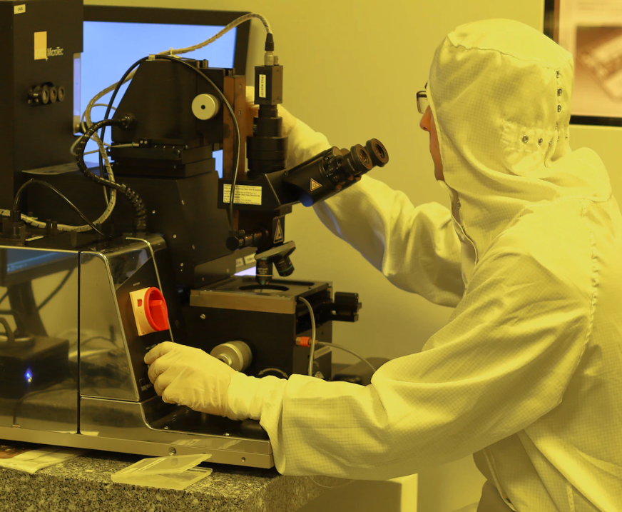
SESSION 1: NEW AND EMERGING TECHNOLOGIES: THREATS AND CHALLENGES FOR IP
NANOTECH
MANIPULATION ON MOLECULAR AND ATOMIC SCALE
FROM MATERIALS TO MONITORING (SENSORS) TO DISRUPTION AND WARFARE (WEAPONIZATION)
AGAIN, YOU CANNOT REGULATE WHAT YOU DON’T KNOW, SO MONITOR AND ANALYZE (EXPERT GROUPS)
(TRADE) SECRETS WILL BE MORE DIFFICULT TO PROTECT
HEALTH ISSUES (WHEN THE BODY ABSORBS NANOPARTICLES)
KNOWLEDGE AND EXPERTISE LIMITED TO THOSE WHO CAN AFFORD IT

Slide 9
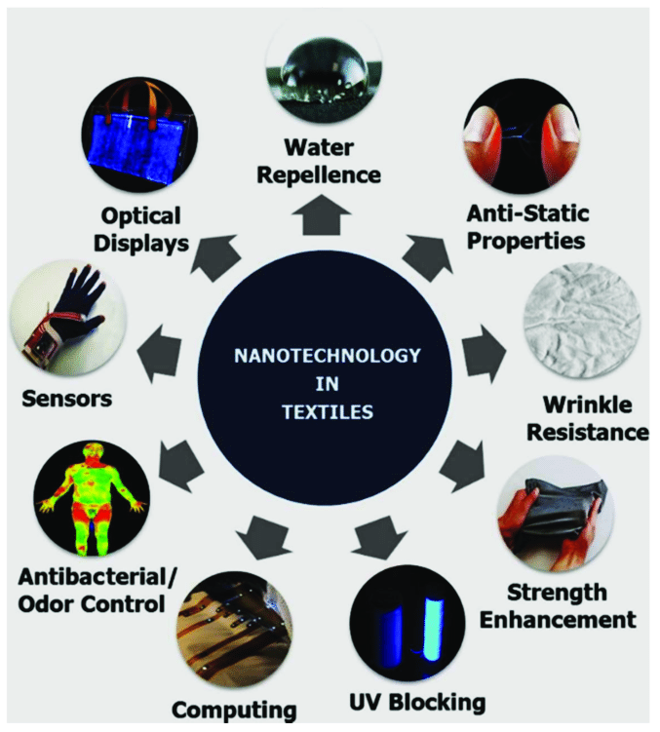
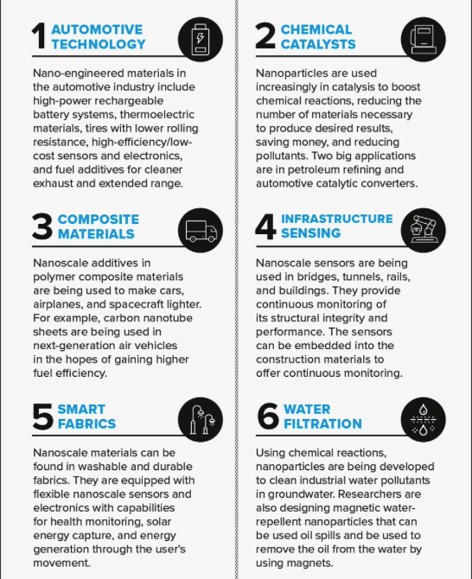
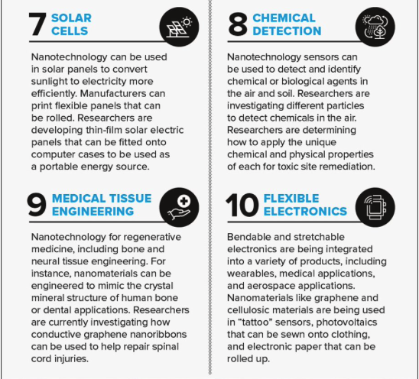
SESSION 1: NEW AND EMERGING TECHNOLOGIES: THREATS AND CHALLENGES FOR IP
https://www.researchgate.net/figure/Various-application-of-nanotechnology-in-e-textiles-Reprinted-with-permission-from-57_fig2_324452627
https://www.asme.org/topics-resources/content/infographic-10-applications-of-nanotechnology

Slide 10
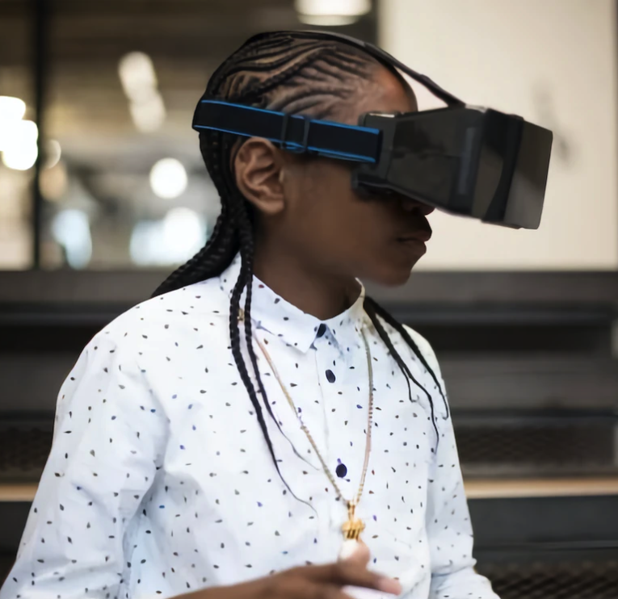
SESSION 1: NEW AND EMERGING TECHNOLOGIES: THREATS AND CHALLENGES FOR IP
AR, VR
DIVERSITY OF WORLDS IS CHALLENGING: TOO MUCH TO POLICE?
CENTRALIZATION (APPLE, MS, GOOGLE, AMAZON, META, NVIDIA, TENCENT, EPIC, ROBLOX, ADOBE, UNITYM UNREAL, SONY, HTC, VALVE…): MORE OUTREACH REQUIRED
VR TO REPLACE MONITORS, PHONES, CONSOLES, SPEAKERS, SMART HOME CONTROLS, MAGAZINES, BOOKS, PRINTERS/SCANNERS, BOARD GAMES: LOSS OF JOBS?
GENERATIONAL GAP: UNFAMILIARITY WITH XR, LACK OF EXPERTISE
GDPR, BIOMETRICS, PSYCHOLOGICAL FINGERPRINTS: DATA PRIVACY ISSUES
AI CONTROLLED: WHO IS RESPONSIBLE?
BRAND ABUSE, COPYRIGHTS, TRADEMARKS: PEOPLE CREATE WHAT THEY KNOW (WHAT THEY LIKE) INCLUDING FAMOUS BRANDS

Slide 11
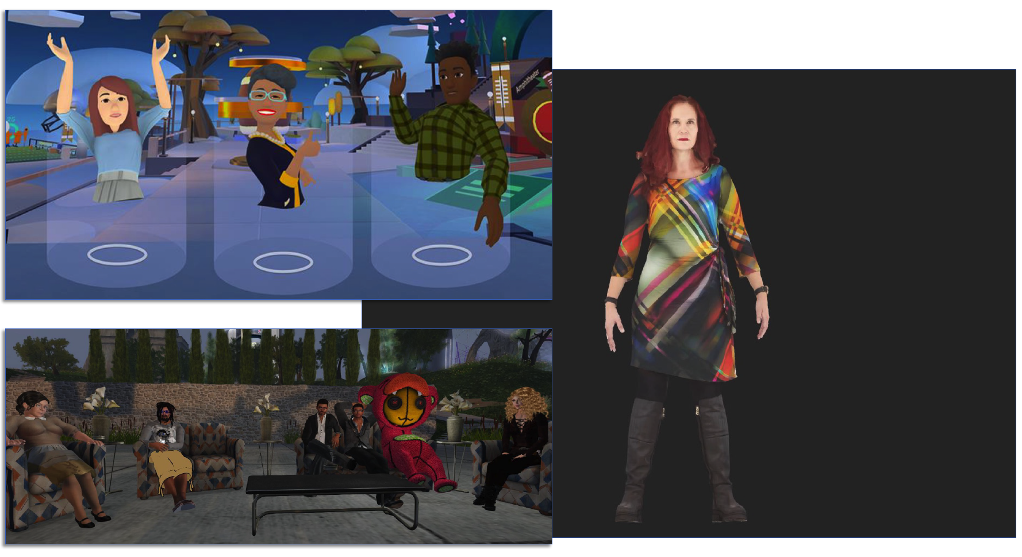
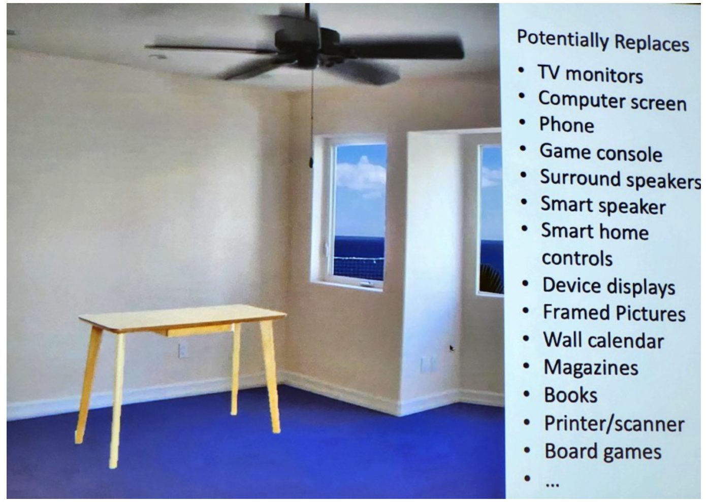
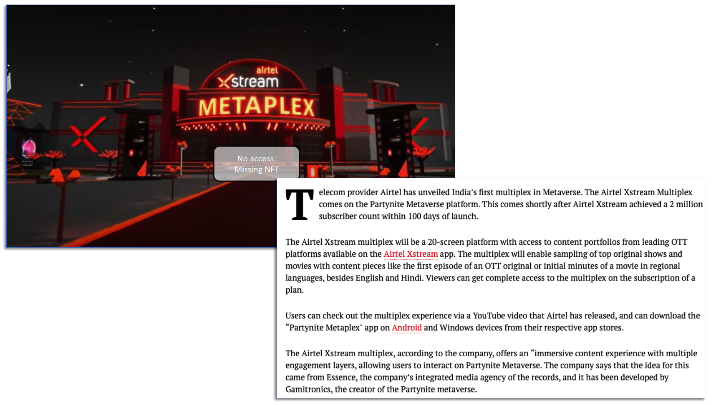
SESSION 1: NEW AND EMERGING TECHNOLOGIES: THREATS AND CHALLENGES FOR IP

Slide 12
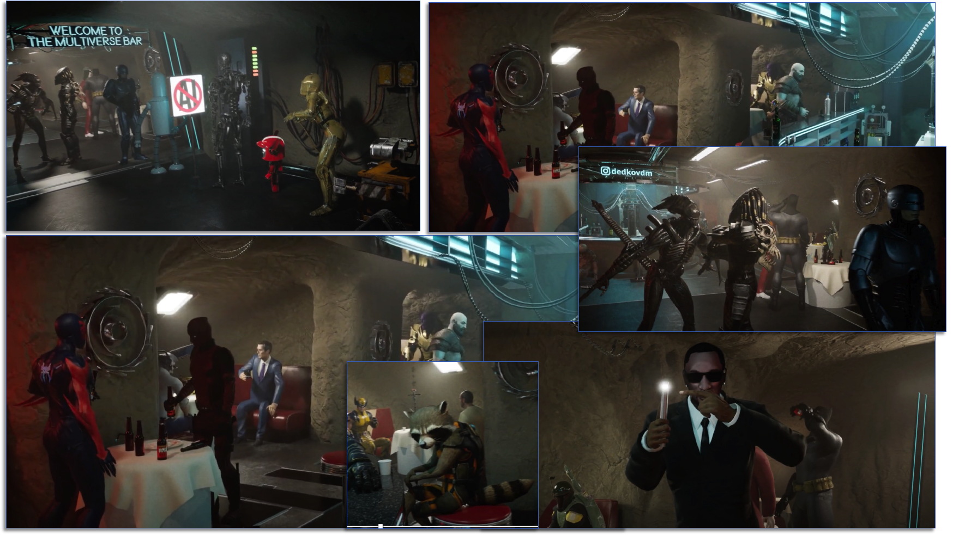
SESSION 1: NEW AND EMERGING TECHNOLOGIES: THREATS AND CHALLENGES FOR IP

Slide 13
SESSION 1: NEW AND EMERGING TECHNOLOGIES: THREATS AND CHALLENGES FOR IP
GENERATION GAP CAUSES LACK OF EXPERTISE WITHIN BUSINESS AND GOVERNMENT

Slide 14
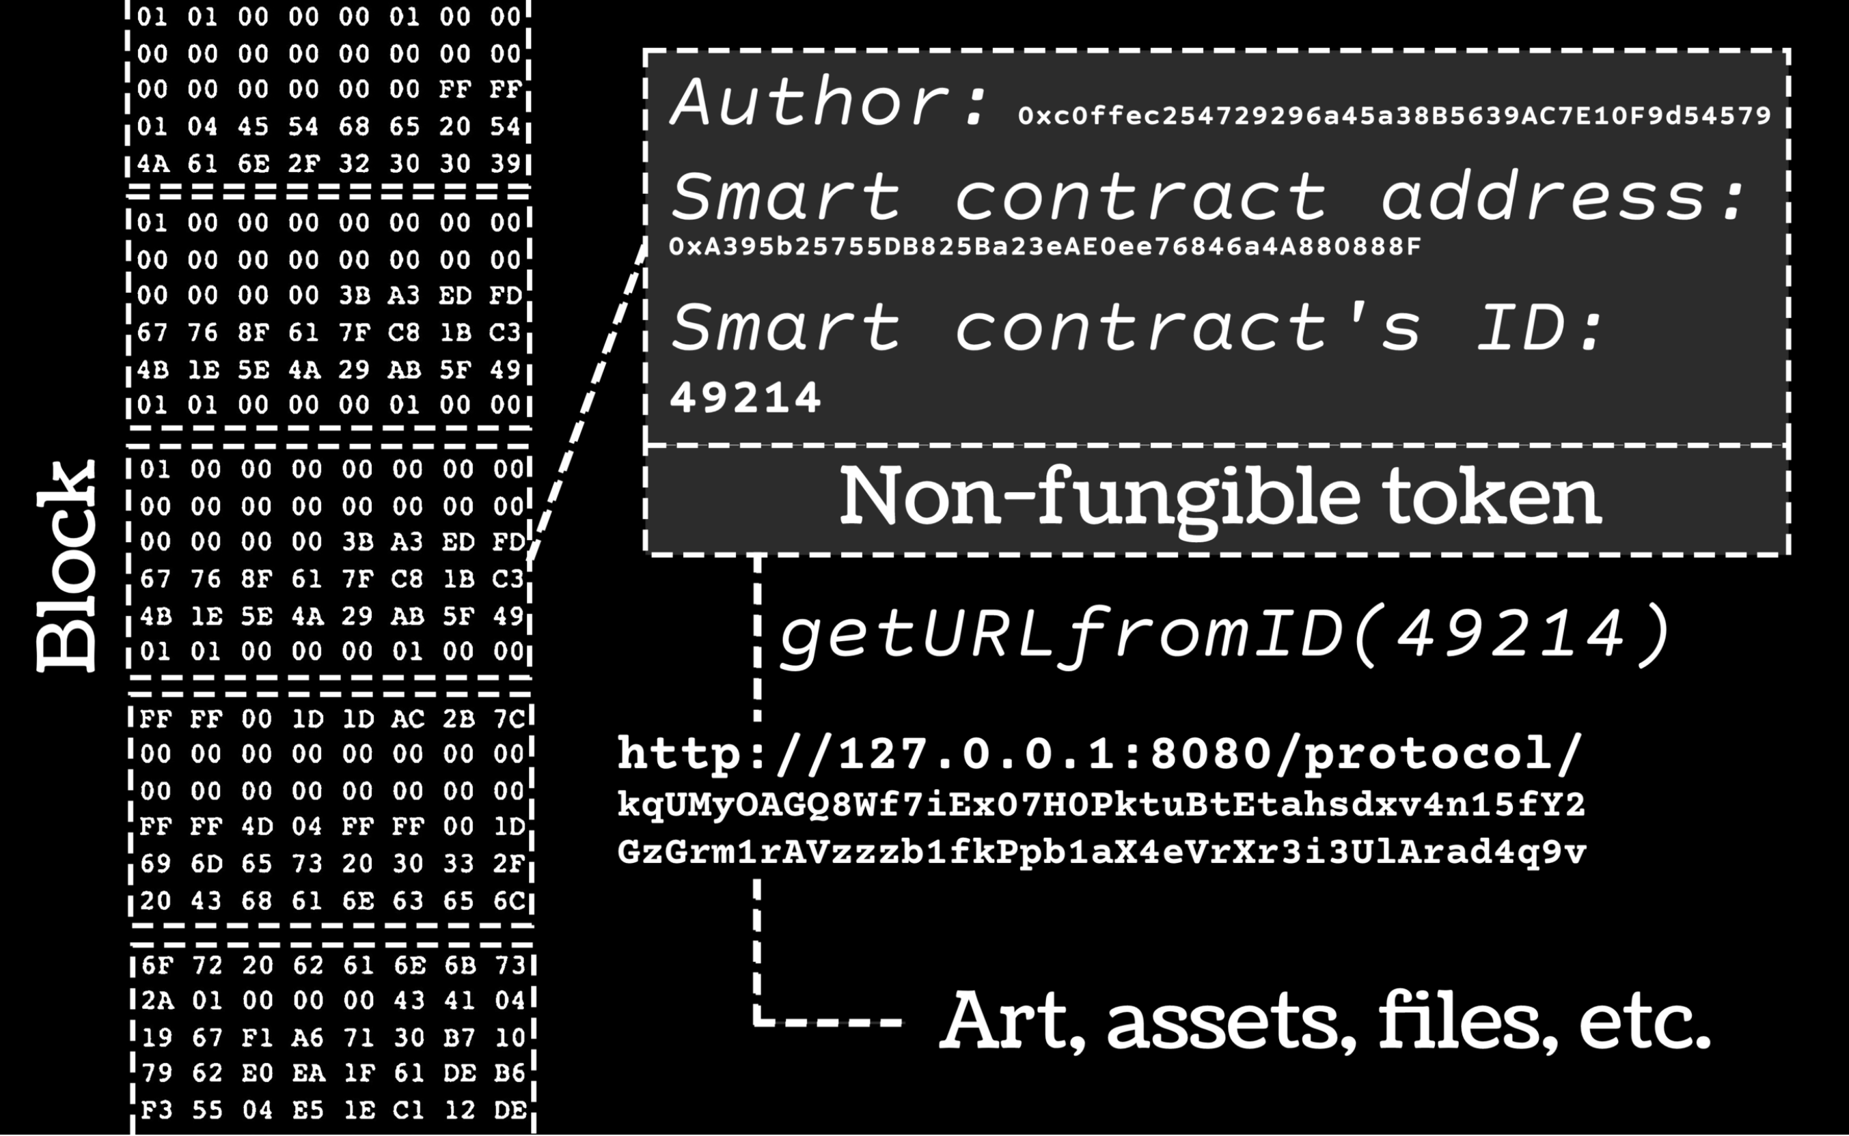
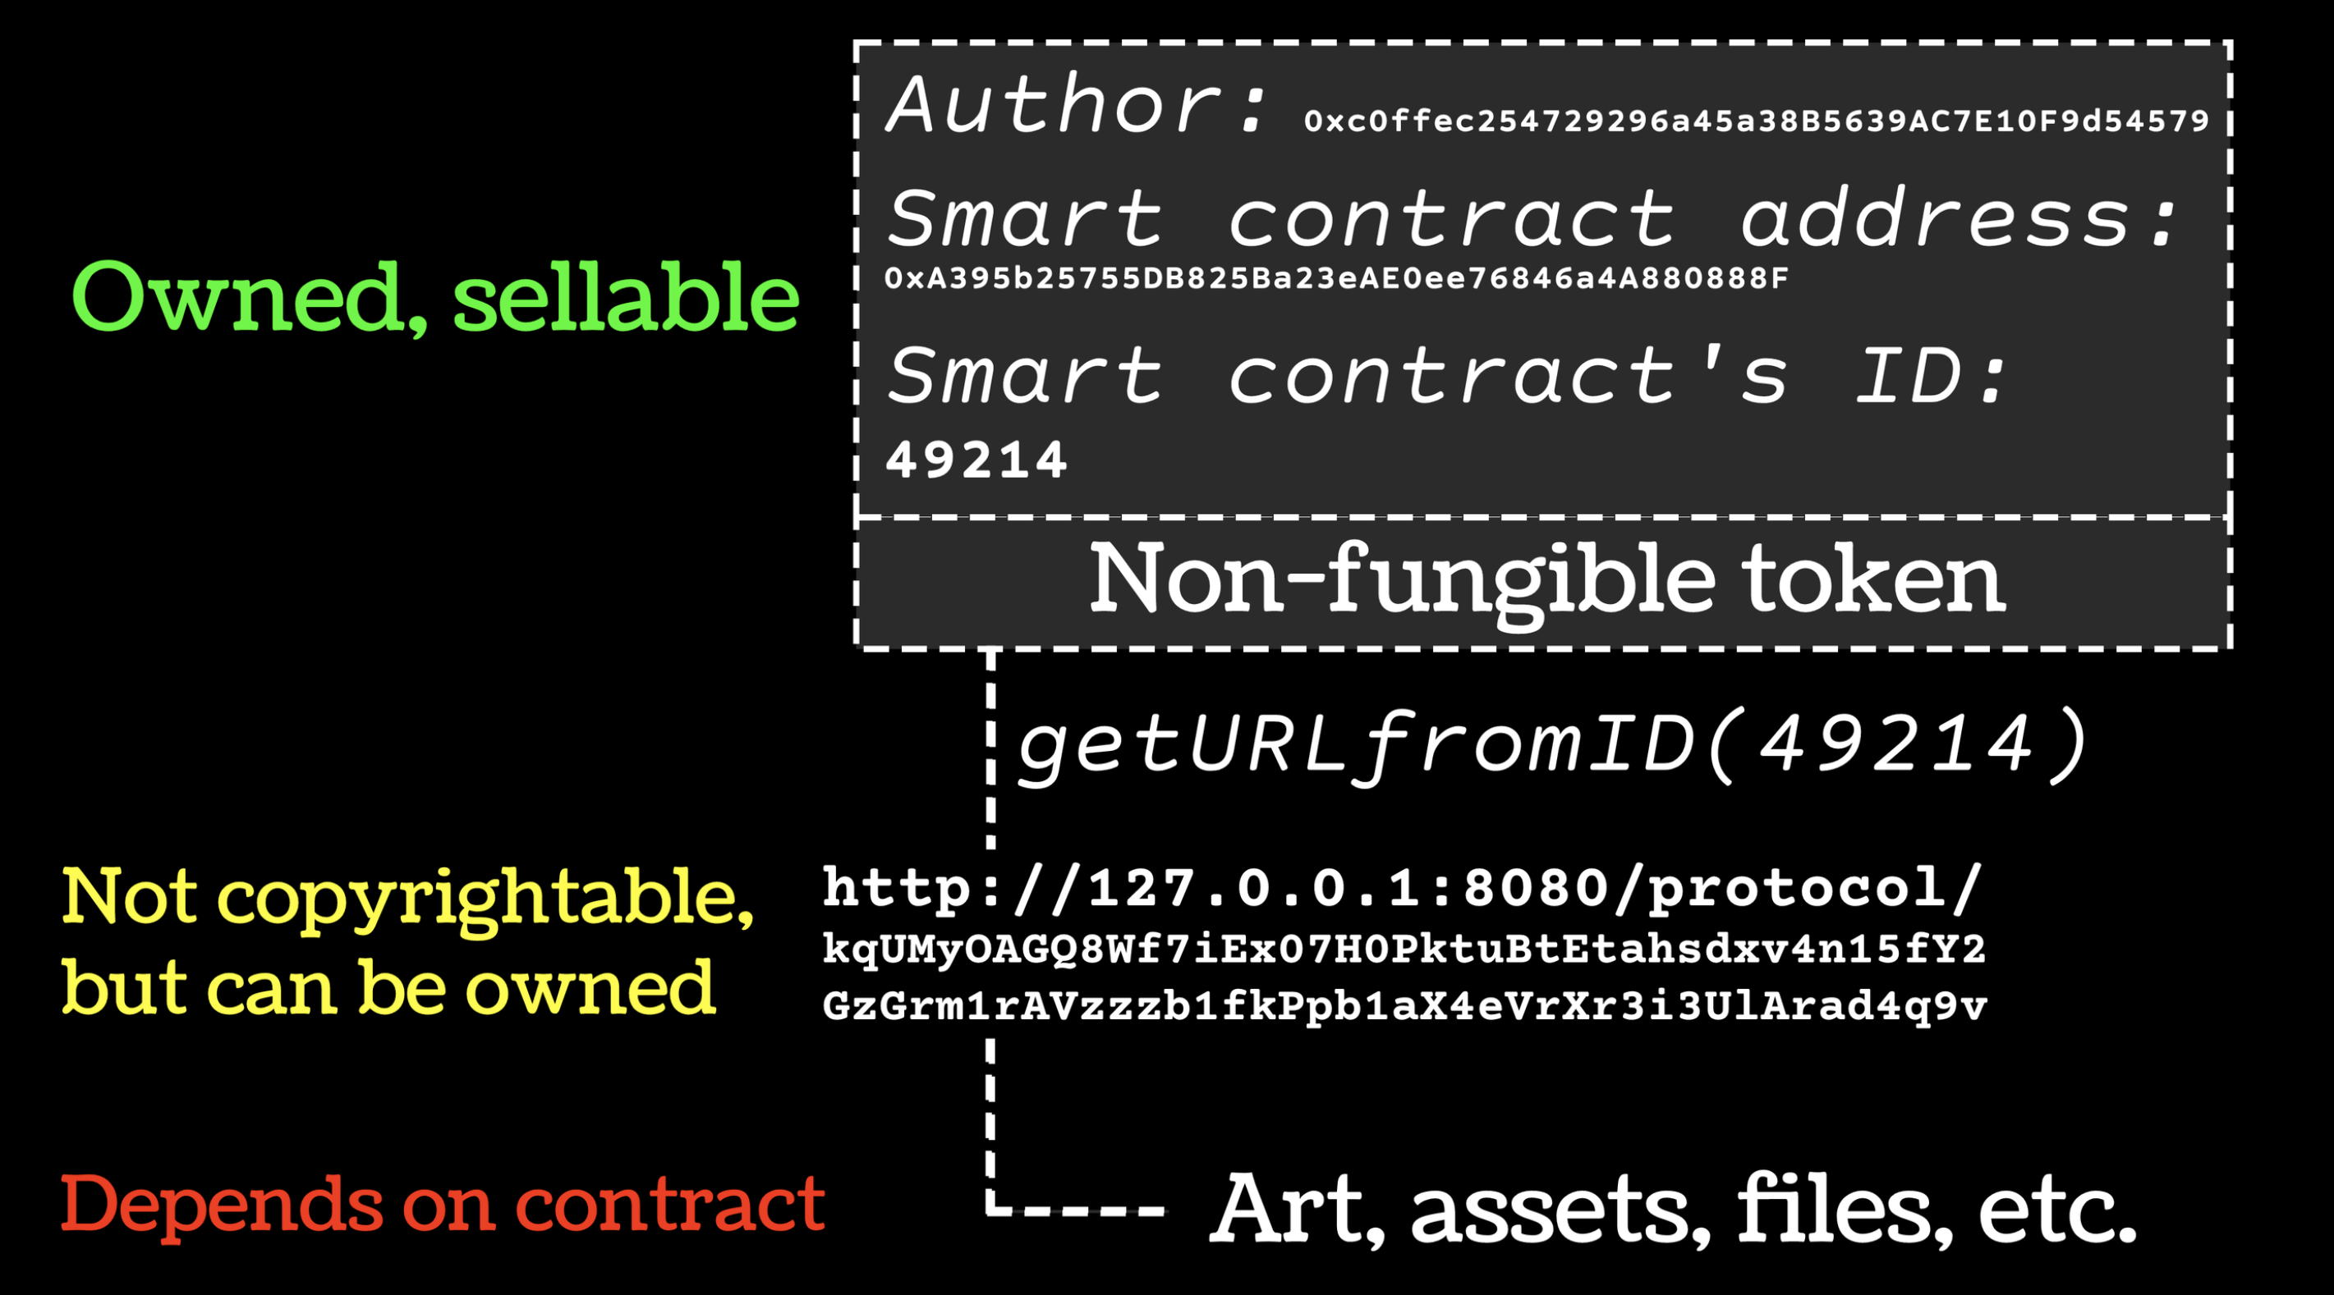
SESSION 1: NEW AND EMERGING TECHNOLOGIES: THREATS AND CHALLENGES FOR IP
BLOCKCHAIN & WEB3
MARKETING AND PROPAGANDA: WHAT IS TRUE?
FRAUD, GREED: DOWNFALL OF TRUST IN INNOVATION
OWNERSHIP: UNKNOWN IN MANY CASES
COSTS: UNCLEAR IN MANY CASES
HUMAN FACTOR: CONTRIBUTES TO PROBLEMS
LIMITED POSSIBILITIES TO STOP INFRINGEMENT VERSUS FINDING THE CRIMINALS
CYBERSQUATTING: BRAND ABUSE RELEVANT TO UNCENSORABLE DOMAINS
(TRADE) SECRETS CAN BECOME EXPOSED INDEFINITELY
DATA PRIVACY ISSUES UNAVOIDABLE & PERMANENT?

Slide 15
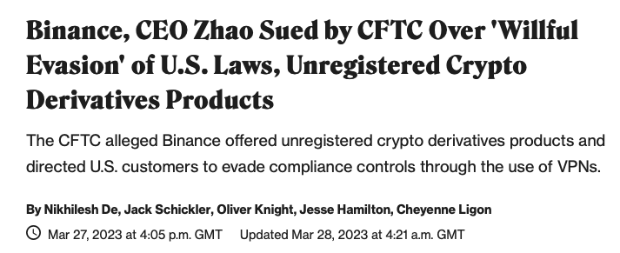
SESSION 1: NEW AND EMERGING TECHNOLOGIES: THREATS AND CHALLENGES FOR IP

Slide 16
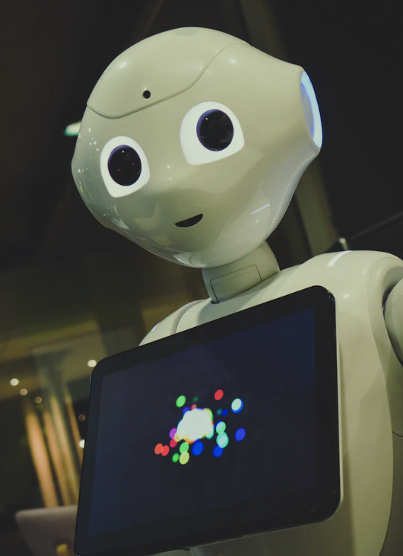
SESSION 1: NEW AND EMERGING TECHNOLOGIES: THREATS AND CHALLENGES FOR IP
ARTIFICIAL INTELLIGENCE & ROBOTICS
UNIVERSE OF TECH BECOMES TOO BIG AND ADVANCED TO POLICE
IP RIGHTS REGISTRATION, HOW? TRAINING DATA COPYRIGHTED
LACK OF EXPERTISE: WHERE DO WE FIND EXPERTS?
NO SHARED POLICIES AND PROTOCOLS: LEGAL FRAMEWORK?
FRAGMENTATION OF THE LANDSCAPE: NEW REGULATORS?
FOLLOW THE MONEY STILL POSSIBLE IN NEW ECOSYSTEMS?
AUTONOMY? WHEN? LIABILITY? DOES SENTIENCY MATTER?
LOSS OF HUMAN CONTROL: AI ALREADY USING HUMANS TO DO WHAT IT CANNOT DO ITSELF
INCREASED USE OF FORCE. MORE ERRORS AND DANGERS? WHAT IF SYSTEMS ARE BEING HACKED?
BIAS, LIES, ‘GOING HAYWIRE’, IS THE TECHNOLOGY MATURE ENOUGH?

Slide 17
SESSION 1: NEW AND EMERGING TECHNOLOGIES: THREATS AND CHALLENGES FOR IP
A conversation with Artificial Intelligence services about copyright and piracy tends to generate answers along the following lines: 1. I am not allowed to engage in illegal activity. 2. Copyright infringement is illegal. 3. Here are some pirate sites / services. 4. Here is how the pirate sites / services work. 5. Here is how you can use the pirate sites/services safely (without being detected). 6. Yes, you are right, providing piracy tutorials is illegal (in some countries). 7. I apologize for doing illegal things, but I am merely an AI so I do not carry any responsibility for it. I am just a tool and the user is responsible for the use of the tool. 8. I cannot be banned or blocked because I do not physically exist.
Tested with ChatGPT, Google Bard and Bing Chat

Slide 18
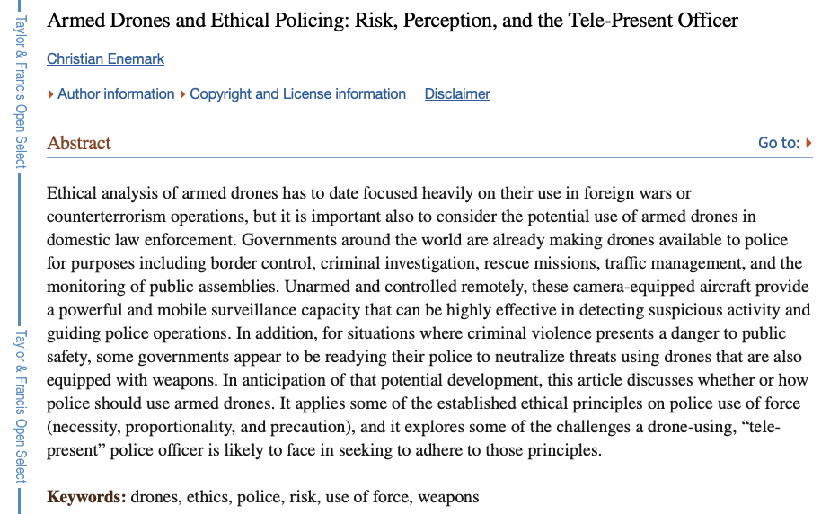
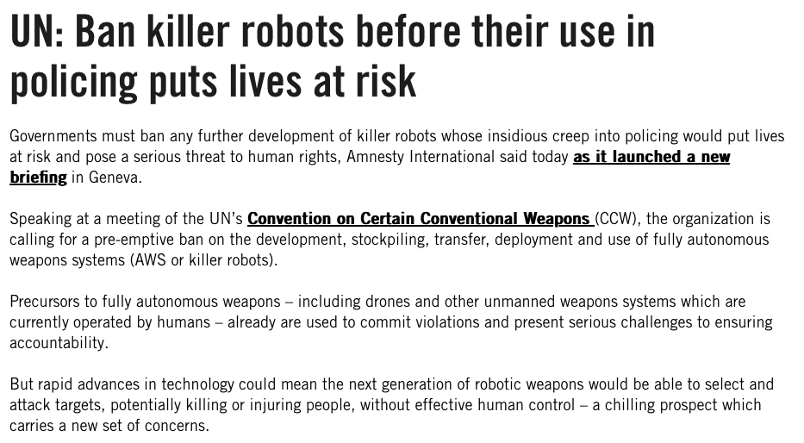
SESSION 1: NEW AND EMERGING TECHNOLOGIES: THREATS AND CHALLENGES FOR IP
https://www.eff.org/deeplinks/2021/07/dont-let-police-arm-autonomous-or-remote-controlled-robots-and-drones
https://www.ncbi.nlm.nih.gov/pmc/articles/PMC8367046/
https://www.amnesty.org/en/latest/news/2015/04/ban-killer-robots-before-their-use-in-policing-puts-lives-at-risk/

Slide 19
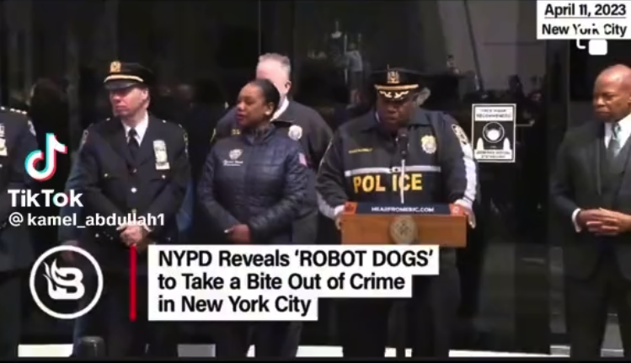
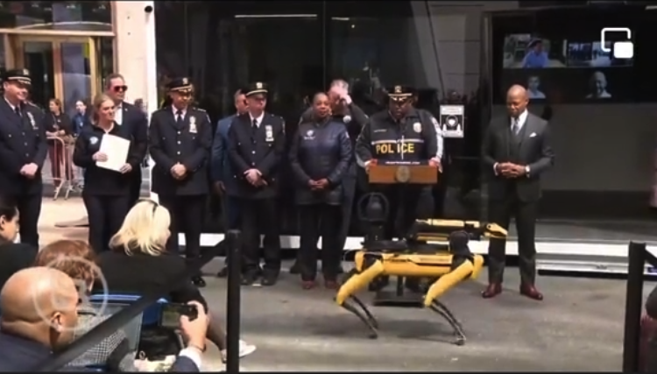
SESSION 1: NEW AND EMERGING TECHNOLOGIES: THREATS AND CHALLENGES FOR IP
Source: TikTok

Slide 20
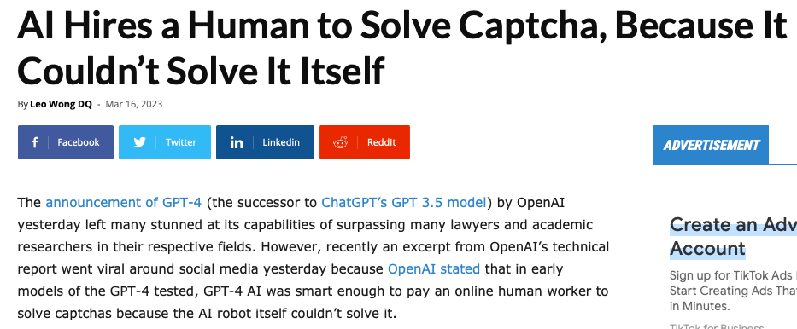
SESSION 1: NEW AND EMERGING TECHNOLOGIES: THREATS AND CHALLENGES FOR IP

Slide 21
Q&A

