Slide 1
Confidentiality and Ensuring Validity
Elina Velpe
Acting Head of the Legal Division

Slide 2
Confidentiality
The content of the exam, including questions and case studies, is kept confidential to maintain the integrity of the examination process. This ensures that all candidates have an equal opportunity and prevents any unfair advantage.
  Personal information of candidates, such as their names and specializations, is protected under data privacy regulations. This information is only used for the examination and is not disclosed to unauthorized parties.
  After the Qualification Examination Commission has been established, each member of the Commission signs a certificate (example in the next slide).

Slide 3
Republic of Latvia Patent Office
Certificate
I, John Doe, as a member of the Professional Patent Attorney Examination Commission, hereby undertake to maintain and not unlawfully disclose information related to the evaluation process of the professional patent attorney examination (Article 5, Paragraph 2, Clause 5 of the Freedom of Information Law), as well as other restricted access information that I process or come into possession of while performing the duties of a member of the professional patent attorney examination commission, including the personal data of candidates for the professional patent attorney examination. I am familiar with the requirements of the Freedom of Information Law and the General Data Protection Regulation (EU) 2016/679 (April 27, 2016) concerning the protection of individuals through the processing of personal data and the free movement of such data, which repeals Directive 95/46/EC.
I undertake not to decide on the permission for a candidate to take the exam and not to participate in the evaluation of the candidate’s work if:
the candidate is the spouse of the commission member, a relative of the commission member, or their spouse in a direct line in all degrees, in a collateral line up to the fourth degree, or in-laws up to the third degree;
the candidate is under the guardianship or trusteeship of the commission member or their spouse;
the candidate is a business partner of the commission member (a natural or legal person with whom the commission member has conducted transactions in the previous year if the transaction amount exceeds 20 minimum monthly wages);
the commission member is associated with the candidate’s workplace (is a current or former employee, official, participant, or shareholder) and has performed control, and supervision functions, or made decisions regarding the candidate;
The candidate is associated with the commission member’s workplace and has performed control, and supervision functions, or made decisions regarding the commission member (in the last 24 months);
the commission member is personally directly or indirectly interested in the evaluation or other circumstances create reasonable doubts about their objectivity.
Riga, ____, 2024
signature

Slide 4
The Qualification Examination Commission informs the candidate about the evaluation of the exam on the next working day following the decision and within three working days sends the decision on the results of the examination electronically or at the address indicated by the candidate.
If the applicant has passed the exam, an extract from the decision will be accompanied by an invitation to apply to the Patent Office within two months to include the necessary information on the Professional Patent Attorney list.

Slide 5
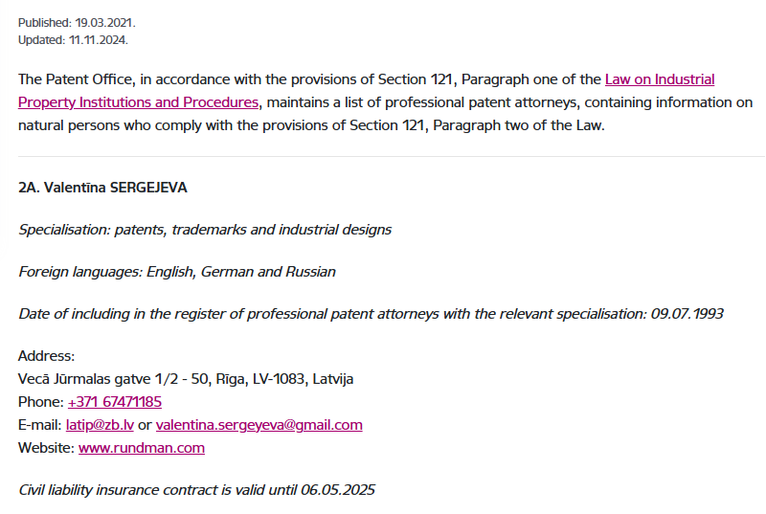
Professional patent attorney list

Slide 6
Ensuring Validity
Qualification and Examination
To become a professional patent attorney in Latvia, candidates must pass a qualification examination. This exam assesses both theoretical knowledge and practical skills in industrial property protection. The examination process is overseen by a commission that ensures the integrity and fairness of the evaluation.
Regulatory Framework
The profession is regulated by the Latvian Patent Office, which sets the standards and requirements for professional patent attorneys. This includes adherence to national laws and European Union regulations, such as the General Data Protection Regulation (GDPR), which governs the handling of personal data.

Slide 7
Ethical Standards
Professional patent attorneys must adhere to strict ethical standards. They are required to maintain confidentiality and avoid conflicts of interest. For example, they must not participate in the evaluation of candidates if there is a personal or financial relationship that could compromise their objectivity.
Continuous Professional Development
To ensure ongoing competence, professional patent attorneys are encouraged to engage in continuous professional development. This includes attending seminars, workshops, and other educational activities to stay updated with the latest developments in legal acts and practices in the field of industrial property.

Slide 8
Oversight and Accountability
The Latvian Patent Office, along with professional organizations, monitors the conduct of patent attorneys. Any breaches of conduct or professional standards can lead to disciplinary actions, including suspension or removal from the professional register.
Transparency and Public Trust
Maintaining public trust is crucial. The Patent Office ensures transparency in its processes and decisions, providing clear guidelines and information to both professional patent attorneys and the public. This helps in building confidence in the patent system and the professionals who operate within it.
By adhering to these principles and procedures, Latvia ensures that its professional patent attorneys are qualified, ethical, and capable of providing high-quality services in the field of intellectual property protection.

Slide 9
Thank you for your attention!
Do not hesitate to ask any questions.

