Slide 1
Confidentiality and ensuring validity
Aleksandra Heromińska
27 November 2024

Slide 2
The qualifying exam is organized by the Polish Chamber of Patent Attorneys
Always in written form
Always takes place at the headquarters
of the Polish Chamber of Patent Attorneys

Slide 3
The qualifying exam
is fully confidential
and coded, at all stages
During the exam
During the evaluation process
by the Examination Board
The publication of results is also coded

Slide 4
Before taking the qualifying exam
THE CANDIDATE
Submits a declaration that he/she
is not in a conflict with any member of the
Examination Board
(professional or personal)
Deposits laptops, phones
and other electronic equipment

Slide 5
Selects an envelope with a digital code to which he/she assigns the personal details (During the exam only the selected digital code can be used)
Identifies the examination paper with the digital code
The same digital code must be used for all 3 days of the qualifying exam
The paper signed with the name and surname can be disqualified and not checked by the Examination Board

Slide 6
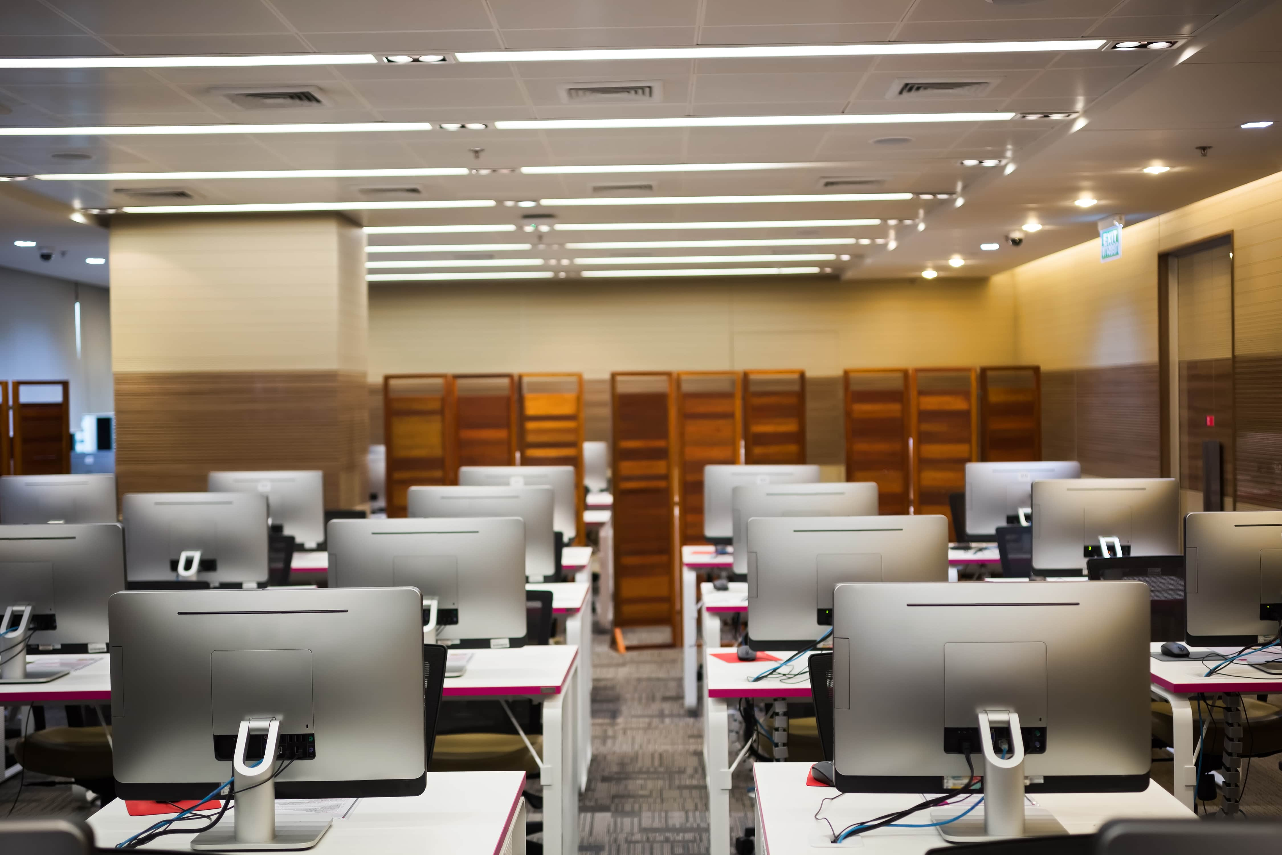
POLISH CHAMBER OF PATENT ATTORNEYS
Allocates a computer to each of the candidates
Assigns a seat numer in the examination
room
(The seat numer is different every day)

Slide 7
During the qualifying exam
The candidate receives a pendrive with
exam questions
The candidate receives a pendrive with
the scanned materials that can be used
The candidate is allowed to use legal acts and commentaries on regulations which he/she must report before the exam starts

Slide 8
During the evaluation proces
The Examination Board checks the coded paper
All stages of the evaluation process
must be coded

Slide 9
After the qualifying exam
The results of the final exam are published on
the Polish Chamber of Patent Attorney’s website
(Always using the digital codes)
The candidate finds his/her own digital code
and thus decodes the paper
(Using an envelope in which the name is assigned to the code)

Slide 10
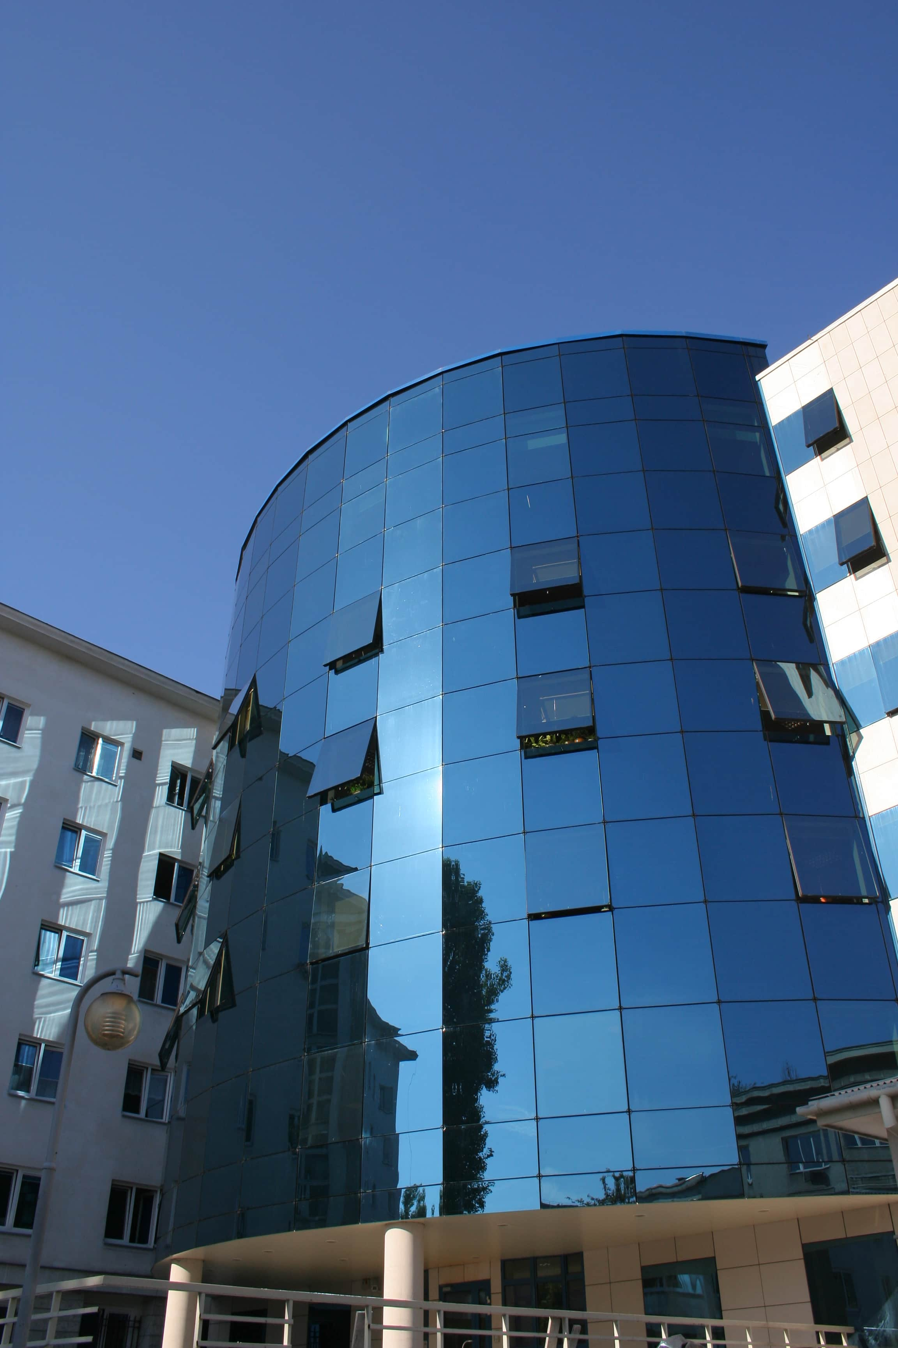
Positive result of the qualifying exam THE CANDIDATE
Takes an oath before the President of the Patent
Office of the Republic of Poland
(Patent Office of the Republic of Poland)
Submits a request to the Patent Office
of the Republic of Poland for entry on the official
list of Patent Attorneys
(Within 6 months from taking the qualifying exam
If this deadline is missed, the qualifying exam must be retaken)

Slide 11
Patent Attorney Certificate obtained in Poland
Authorizes to be a professional representative
in the field of Industrial Property Rights specified
in the Act of 30 June 2000 – Industrial Property Law

Slide 12
inventions
utility models
trademarks
industrial designs
geografical indications
topographies of integrated circuits

Slide 13
Allows to submit an application to the European Union Intellectual Property Office (EUIPO) in Alicante for entry on the list of professional representatives before the EUIPO
trademarks
industrial designs

Slide 14
Thank you for your attention ☺
Aleksandra Heromińska
Aleksandra.herominska@uprp.gov.pl

