Slide 1
Exam Paper creation: Identifying and Cooperating with Experts
Aleksandra Heromińska
27 November 2024

Slide 2
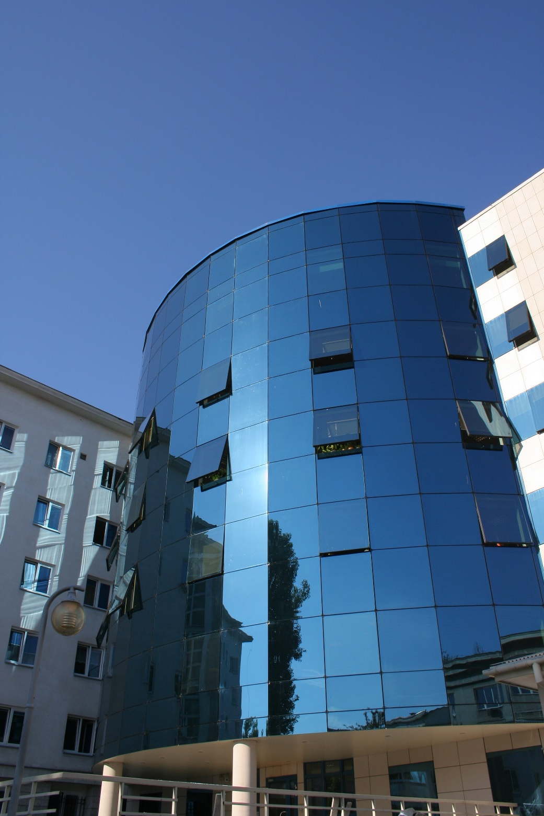
The qualifying exam is conducted by the Polish Chamber of Patent Attorneys in cooperation with the Patent Office of the Republic of Poland

Slide 3
The qualifying exam is always in written form
The exam paper is idenfified with a digital code
The papers are written on computers assigned by the Polish Chamber of Patent Attorneys

Slide 4
The qualifying exam consists of
Three written parts
Three days/5 hours each (All parts are descriptive, not tests)

Slide 5
Each day covers one topic to write about and its scope is specified in the Act on Patent Attorneys

Slide 6
The first question (day 1) covers (An examiner in the field of patents and inventions is selected to evaluate the examination paper)
documentation of the application for granting protection for an invention
(patent application)

Slide 7
The second question (day 2) covers (An examiner or patent attorney is selected to evaluate the examination paper)
preparation of procedural documents in administrative, court-administrative or civil proceedings

Slide 8
The third question (day 3) covers (legal case) (An examiner or patent attorney is selected to evaluate the examination paper)
preparation of an opinion based on the presented factual circumstances or resolution of a legal problem based on the described case

Slide 9
Questions or topics are selected in accordance with the above scope indicated in the Act on Patent Attorneys under the supervision of the chairperson of the Examination Board

Slide 10
Candidates receive questions on a pendrive prepared in advance by a group of experts

Slide 11
Patent Office examiners
Are members of the Examination Board (3 persons)
Participate in preparing questions and evaluation process
Are selected depending on their specialization, experience and the scope in which they are professional experts

Slide 12
Thank you for your attention
Aleksandra Heromińska
Aleksandra.herominska@uprp.gov.pl

