Slide 1
Overview of Patent Attorney and Paralegal Qualification in the EPO
Jakob Kofoed Principal Advisor DG5

Slide 2
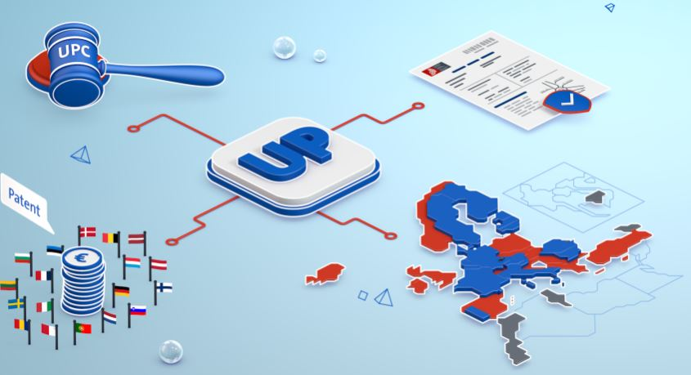
2023/2024 Highlights
Celebrating 50 years of the European Patent Convention on 05 October 2023
Launch of the Unitary Patent on 01 June 2023
Launch of the Observatory on Patents and Technology on 01 October 2023
Validation agreement with Georgia – Entry into force on 15 January 2024
Publication of Strategic Plan 2028 on 20 March 2024
Romania joined the UP system on 01 September 2024

Slide 3
Background EQE
European Qualifying
Examination
(EQE)
Well established & highly respected worldwide as the entry into the profession as European Patent Attorney.
15.000 epi members passed the EQE and represent Parties before the EPO as stipulated in articles 133-134 EPC.
A very high proportion of files in Examination are handled by the 15.000 members of epi.
The EQE is regulated by the REE as decided by the EPO AC. Major EQE revision by AC December 2023.
Notes:
The EQE is well known as the entry into the profession as European Patent Attorney.
Around 15.000 passed the EQE and are now member of the epi and can thus represent Parties before the EPO e.g. as stipulated in articles 133-134 EPC.
Since 1994, EPO Examiners can also sit the EQE and hundreds did successfully do so.
European patent system users have few options when it comes to certification schemes for paralegals and administrative staff – e.g. FO colleagues in DG1 - working in intellectual property rights. While some opportunities exist in a limited number of countries, demand at the European level is growing also in view of the upcoming Community Patent. To address these needs, the Office developed the EPAC, offering tailor-made training in dedicated courses and providing a new high-quality certification. For EPO formalities officers, EPAC could help foster job mobility and presents an exciting new path & personal asset in professional growth.

Slide 4
EQE Details
Exam for up to 3000 Candidates every year.
EQE is open for Examiners since 1994 and forms an important personal development & career opportunity for EPO DG1 staff.
Around 100-200 Examiners (re)sit papers every year.
Pre-Exam with legal & technical content. Multiple choice.
Papers A-D. Technical & Legal.

Slide 5
EQE strategic impact on EPO quality
The EQE is basically designed to test an attorney for “fit to practice” before the EPO.
Strong emphasis on high quality level drafting, amending and correctly arguing substantive matters (patentability) next to handling formal & legal issues under the EPC & PCT.
The EQE is the central element ensuring high quality at source of EPO incoming work and smooth processing of files in cooperation between 15000 epi attorneys and EPO FO and Examining staff.

Slide 6
Current EQE regulations.
Pre-Exam with legal and technical MC questions. 2Y.
Paper A is directed at checking your ability to draft a set of claims with an introductory part of a description.
Paper B is directed at checking your ability to draft a full response to a communication issued by the EPO during examination of a European patent application.
Paper C is directed at checking your ability to draft an opposition to a granted European patent.
Paper D first part is aimed at checking your legal knowledge about various aspects of the EPC and the PCT. The second part aims at drafting a legal opinion.

Slide 7
The new eqe
Fit to practice in a digital age

Slide 8
The New EQE Package
What is the new EQE?
Modules and scope
Transitional provisions
Roll-out schedule

Slide 9
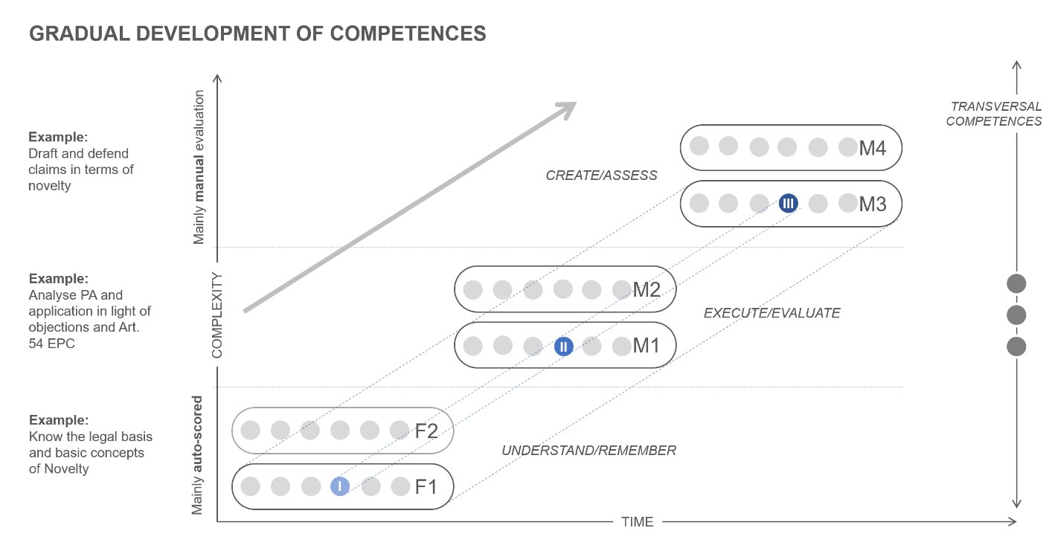
Based on activity of the daily job of a patent attorney: assessing information, drafting documents, advising the client; etc
Less formalistic and close to reality: covers more actions and candidates do not know
Questions based on cases and scenarios, and require using all sorts of patent doc

Slide 10
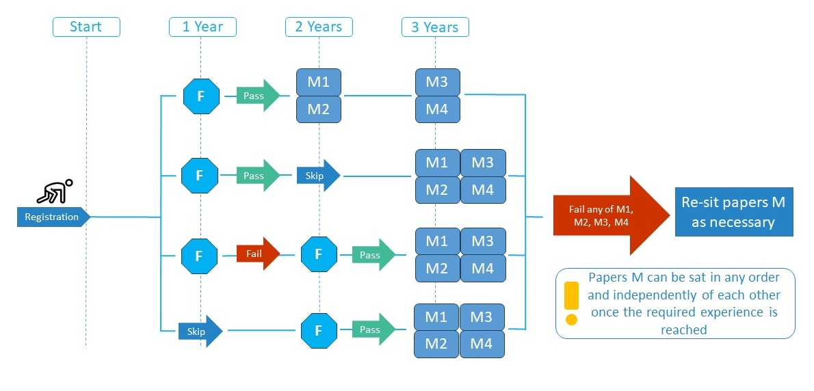
New EQE.

Slide 11
Relevant and useful links.
EQE - European qualifying examination | epo.org
Qualifying as a European Patent Attorney - epi (patentepi.org)

Slide 12
EPAC Background
European patent system users have few options when it comes to certification schemes for paralegals and administrative staff
While some opportunities exist in a limited number of countries, demand at the European level is growing also in view of the upcoming Community Patent
To address these needs, the Office developed the EPAC
offering tailor-made training in dedicated courses
providing a new high-quality certification
For EPO formalities officers, EPAC could help
foster job mobility
present an exciting new path
be personal asset in professional growth
Notes:
The EQE is well known as the entry into the profession as European Patent Attorney.
Around 15.000 passed the EQE and are now member of the epi and can thus represent Parties before the EPO e.g. as stipulated in articles 133-134 EPC.
Since 1994, EPO Examiners can also sit the EQE and hundreds did successfully do so.
European patent system users have few options when it comes to certification schemes for paralegals and administrative staff – e.g. FO colleagues in DG1 - working in intellectual property rights. While some opportunities exist in a limited number of countries, demand at the European level is growing also in view of the upcoming Community Patent. To address these needs, the Office developed the EPAC, offering tailor-made training in dedicated courses and providing a new high-quality certification. For EPO formalities officers, EPAC could help foster job mobility and presents an exciting new path & personal asset in professional growth.

Slide 13
EPAC Background
Following the decision of the President of the European Patent Office dated 20 April 2022 adopting rules concerning the establishment of a European patent administration certification, an EPAC Board composed of six EPO employees and six external experts, including a chairperson and their deputy has been constituted.
EPAC takes place once per year. The 2022-2024 EPAC Exam can be found on the EPO Website
First part is multiple choice / Second part to be answered in text (only marked if first part passed)
EPAC Rules decided by the EPO President can be found also on the EPO Website

