Slide 1
Preparatory Course Designs: Linking with Exam Requirements
Jakob Kofoed Principal Advisor DG5

Slide 2
EQE Teaching institututions
epi (the profession) for training on the job
epi: dedicated training courses (for paper F in cooperation with the EPO)
epi: concept of student membership
CEIPI, Maastricht, …: Universities providing dedicated training
Commercial: DeltaPatents and others

Slide 3
EQE preparation

Slide 4
EPAC training BY DG5 EPO
The EPAC syllabus contains, so far, five modules. One module is taught each month, from March to July:
Understanding patents
EPO procedure from filing to search results
a. EPO procedure from entry into examination to validation b. The Unified Patent Court and the Unitary Patent
PCT procedure
Entry into the national/regional phase after PCT
Notes:
This course for the European patent administration certification (EPAC) comprises five modules, with one module scheduled per month.

Slide 5
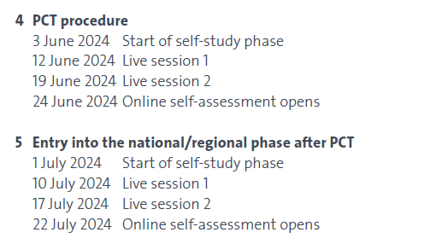
Structure of the EPAC training modules
Each training module comprises:
An online, self-learning phase. Candidates access the training material through a Moodle course room.
2 online sessions:
Trainers present the main takeaways of each module
Q&A
An online self-assessment, based on automated quizzes.
Participants will still be able to access training material and their self-assessments, and use the forum
to exchange views right up until the EPAC examination takes place.
Notes:
Each module starts with a self-study phase of approximately two weeks followed by two online sessions. In the first online session, two EPO tutors will present the key takeaways from the training material and answer the main points raised in the forum. There will also be time for questions and answers. The second online session will focus on participants’ questions.
Each online session will last around two hours.
Candidates will be invited to perform a self-evaluation of their understanding of the module after the second online session.
The online sessions will be held in English, but participants can also interact with the tutors in French and German.
Overall, the course is expected to last 64 hours: with eight hours of self-study and four hours of online sessions per module, plus four hours for the new module on the Unified Patent Court and the Unitary Patent.

Slide 6
Participation to the training
2024
2023
810 participants registered in total
73,4% indicated their intention to pass the exam
 | Registered participants | Participants intending to take the EPAC
All | 855 | 619 (72,43%)
EPO staff | 51 | 37 (72,5%)

Slide 7
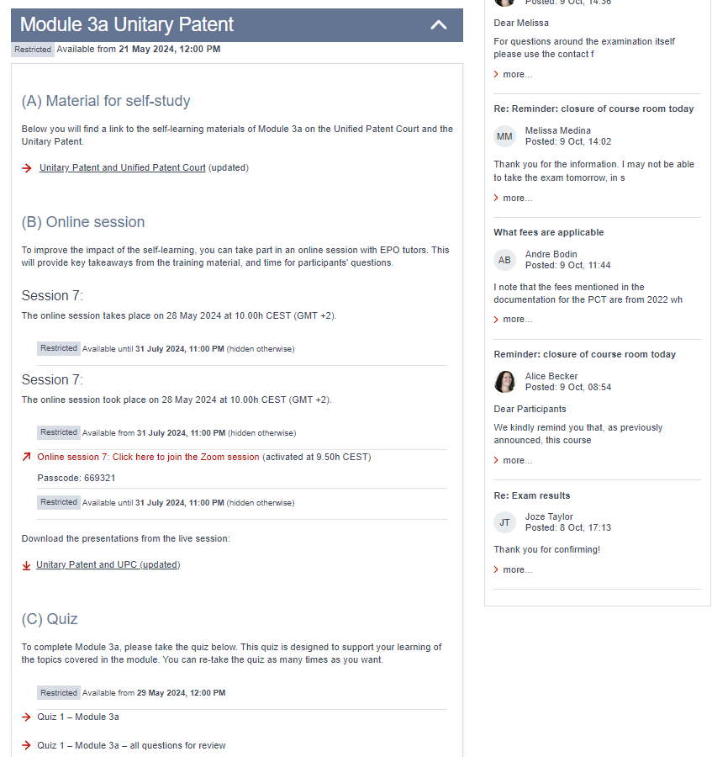
Course room screenshots

Slide 8
Example of training material
Self-learning
Presentations for the online sessions

